Slide 1
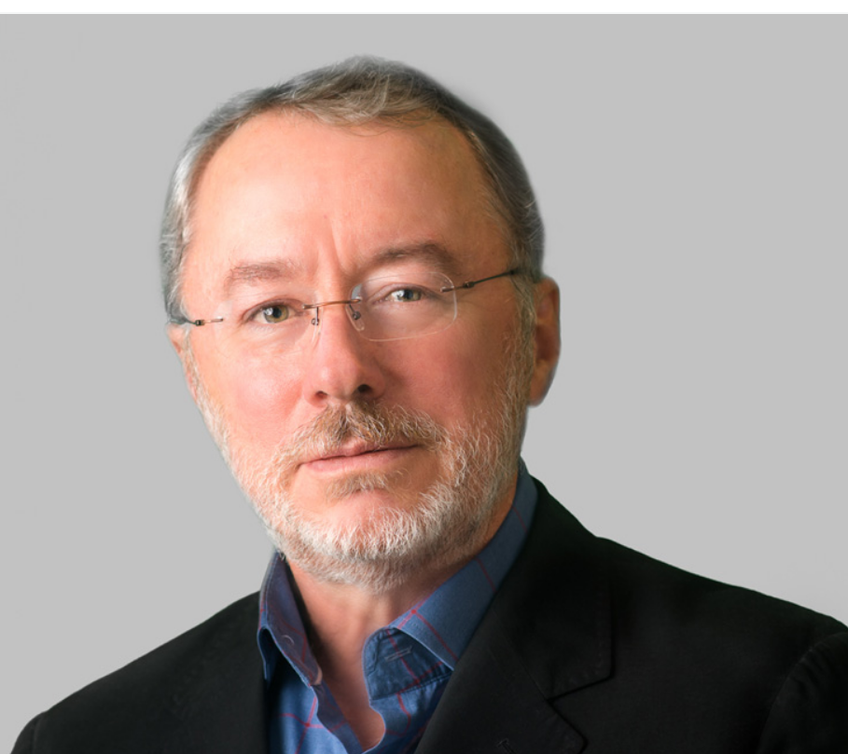
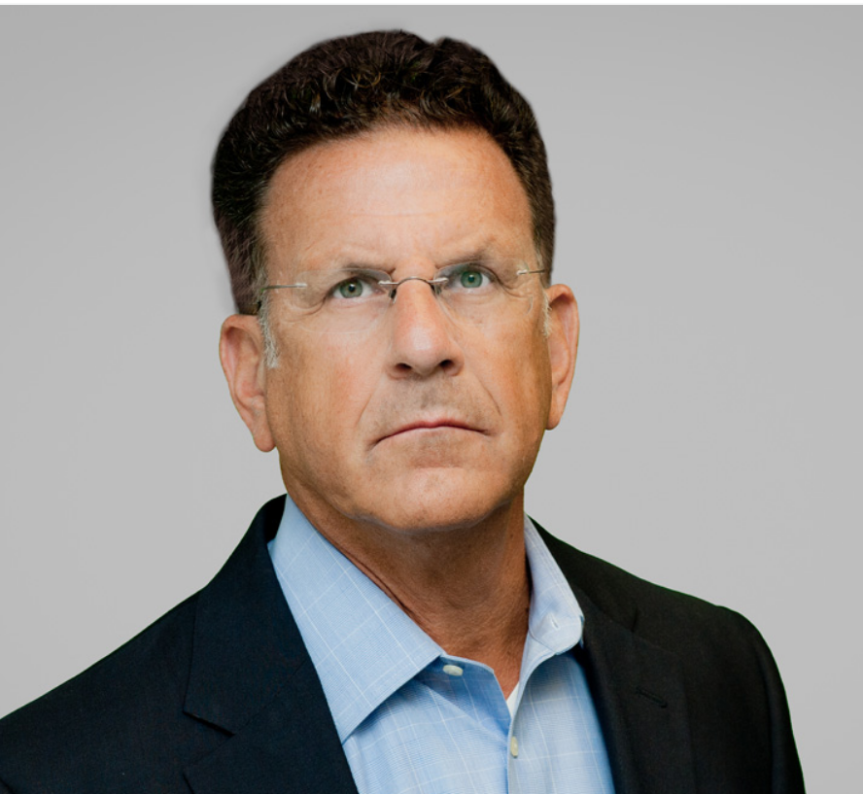
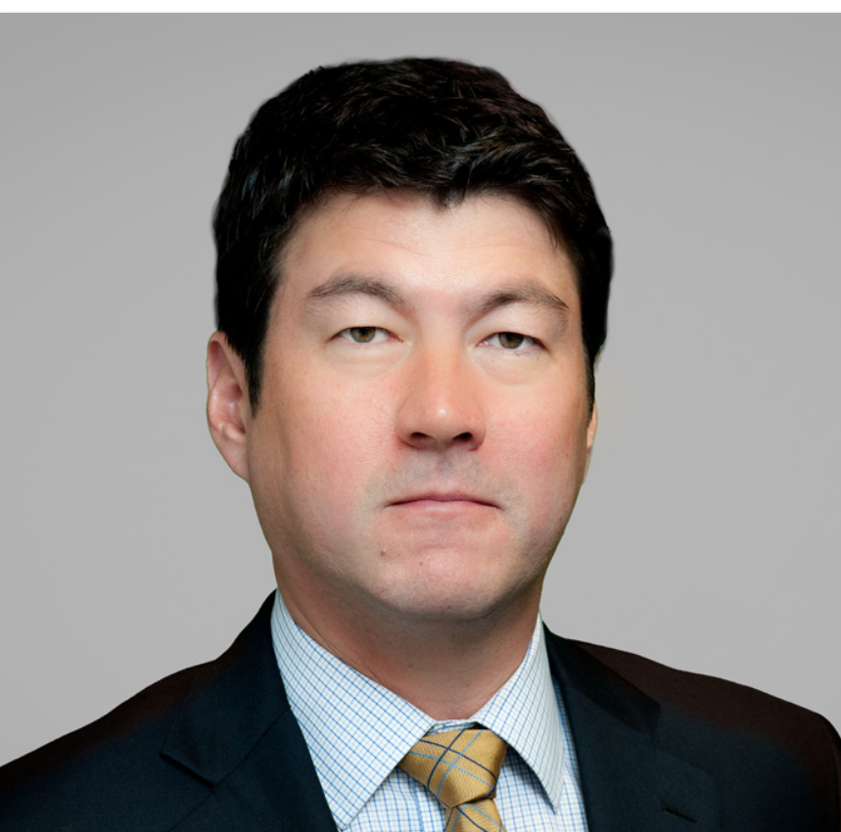
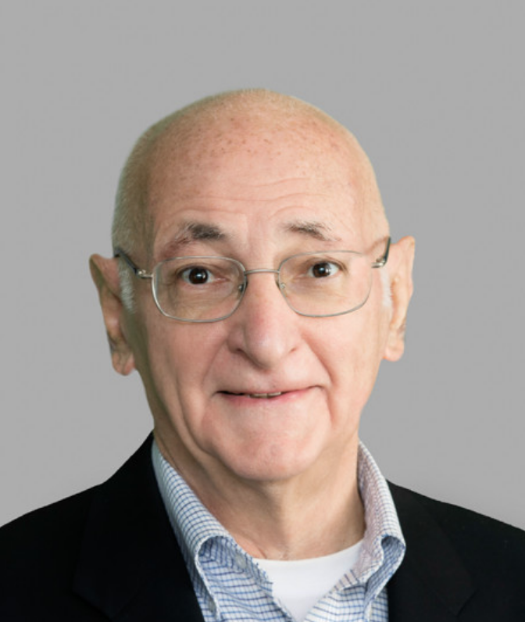
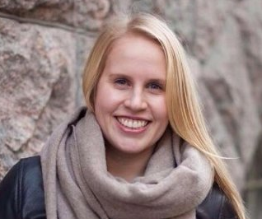
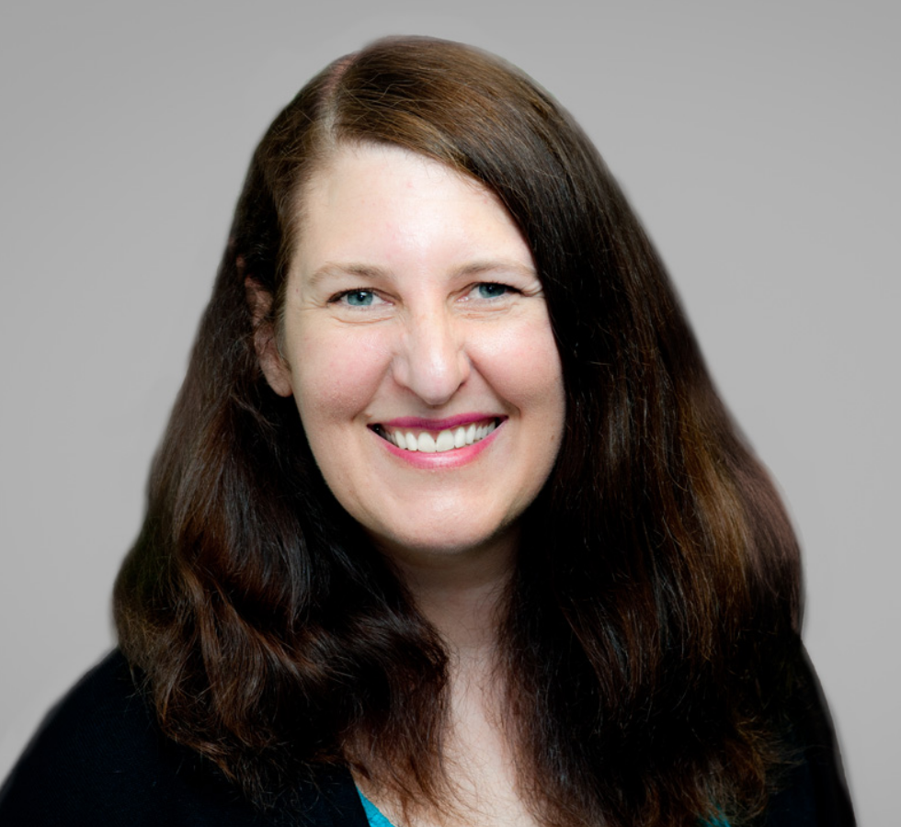
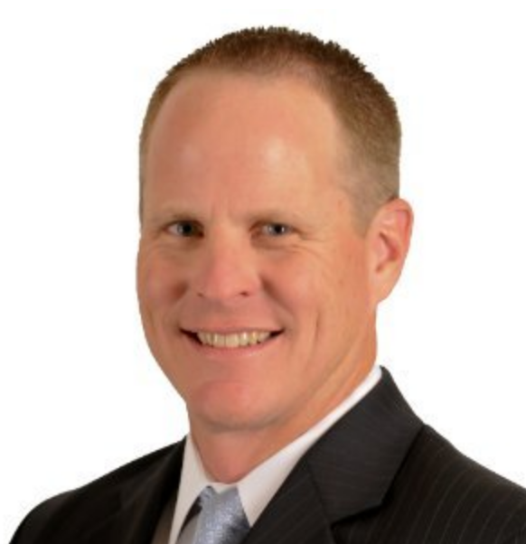
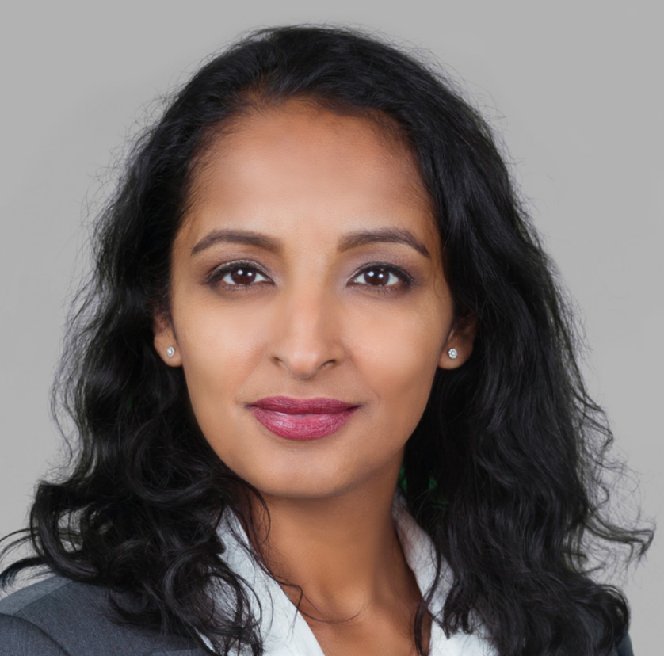
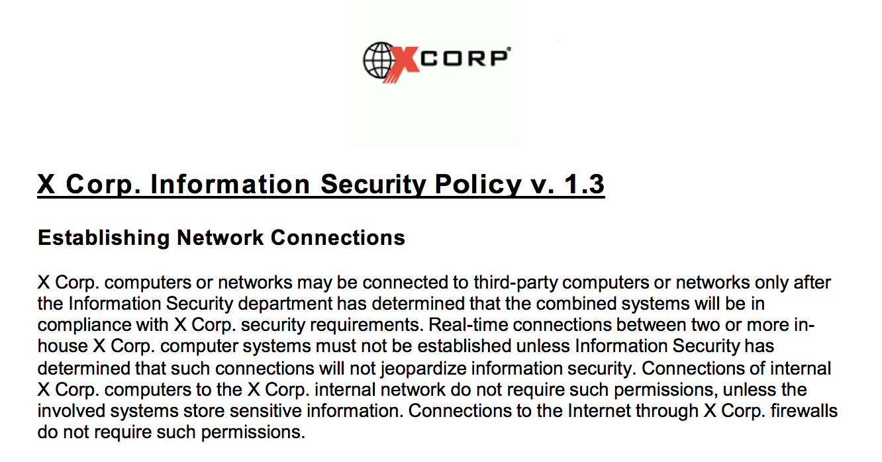
DATA BREACH SIMULATION TRAINING
WELCOME! 8:45am – 9am TEAM INTRODUCTIONS
Please find your assigned team table and introduce yourself to your Team Leader(s) and the other members of your team.
Please write your name on the back of your name sign with the sharpies provided.
TEAM 1
Tom Hemnes
TEAM 2
Rick Olin
TEAM 3
Paul Jean
TEAM 4
David Bender
Mirjam Supponen
TEAM 5
Jennifer Lavalley
Eric Ratcliffe (360Advanced)
TEAM 6
Laila Paszti
Please review the intentionally incomplete incident response plan handout at your table and see how many different things your Team can find that are wrong with it.
For purposes of the simulation exercise, we will all be working at Serious Financial bank.

Slide 2

DATA BREACH SIMULATION TRAINING
JANUARY 12, 2017
INTRODUCTION
Sayoko Blodgett-Ford, Member, GTC (CIPP/US)

Slide 3
DATA BREACH SIMULATION - PANELISTS
Rocco Grillo, Executive Managing Director/Cyber Resilience Leader, Stroz Friedberg/Aon. Mr. Grillo regularly advises clients, including boards and executive management, on a wide range of cybersecurity issues across all industries. Mr. Grillo has more than 25 years of experience providing organizations with security and risk management services. He is an internationally recognized expert in the field of Incident Response and information security and has assisted corporations, law enforcement agencies, major law firms, and industry threat intelligence organizations with matters involving computer security incident response & computer forensics, and security threat advisory services.
Peter Lefkowitz, Chief Privacy Officer and Senior Data Rights Management Counsel, GE Digital. Mr. Lefkowitz is the Chief Privacy Officer and Senior Data Rights Management Counsel at GE Digital and supports GE’s Digital business, including GE’s Predix platform and internet-connected products and predictive analytics solutions. He served as GE’s Chief Privacy Officer from 2013-16. Previously, he was Vice President of Privacy and Security Legal and Chief Privacy Officer at Oracle Corporation.
Patrick Ford, Chief Information Security Officer, Americas Region, Schneider Electric. Mr. Ford is the Chief Information Security Officer for the Americas Region at Schneider Electric. Previously, he was the Senior Principle Advisor at Protiviti. He served as the Vice President, Corporate Security at Aetna, Inc. and was the Senior Director of Global Security for the Americas Region for Pfizer, Inc. He also was a Supervisory Special Agent at the Federal Bureau of Investigation from 1991-2005.
Sayoko Blodgett-Ford, CIPP/US, Member, GTC Law Group PC and Affiliates. Ms. Blodgett-Ford’s practice focuses on intellectual property strategy and transactions and data privacy and security law. She has extensive expertise in due diligence in connection with technology M&A transactions. She is an Adjunct at the Boston College Law School and a Lecturer in Law at the University of Hawai’i law school. She previously served as General Counsel of Tetris Online, Inc. and as Senior Manager of the Intellectual Property Group at Nintendo of America Inc. in Redmond, Washington.

Slide 4
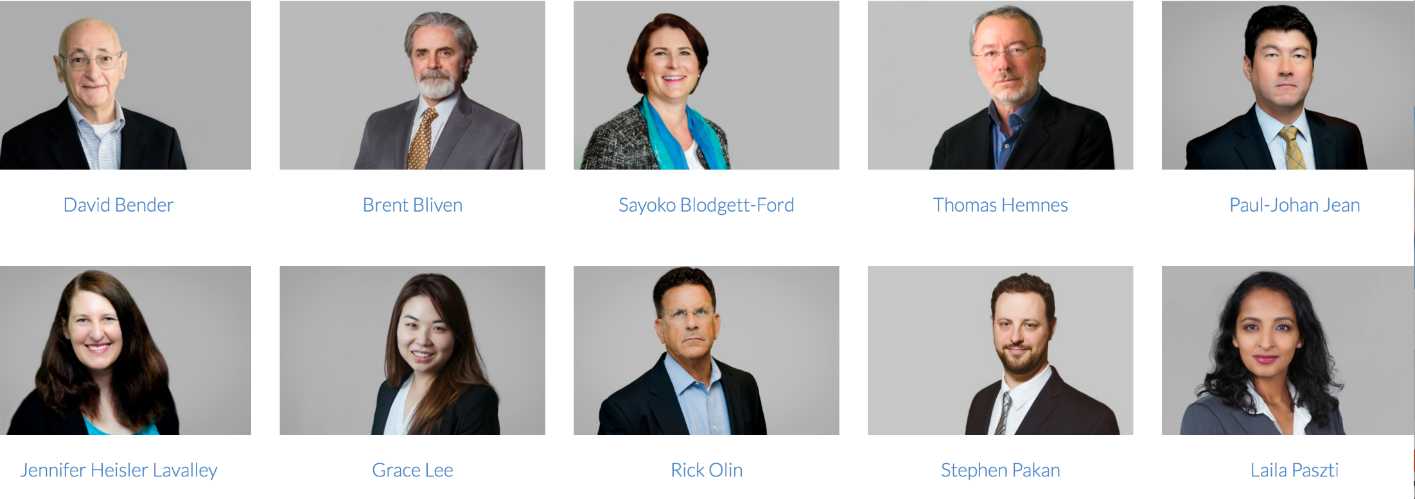
DATA PRIVACY & SECURITY
TEAM
Mirjam Supponen

Slide 5
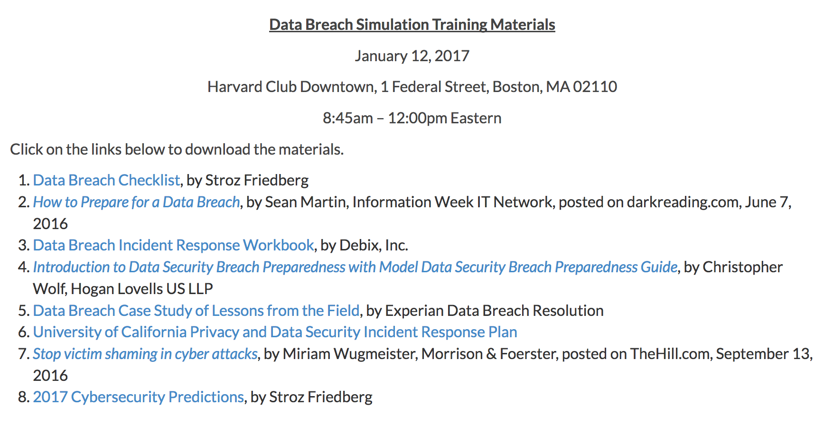
REFERENCE MATERIALS - AVAILABLE ON GTC SITE Harvard Club WIFI Password = veritas415
http://gtclawgroup.com/2017/01/data-breach-simulation-training-materials
PLUS THE “INTENTIONALLY INCOMPLETE” X CORP DOCUMENT
PASSWORD “GTC1”

Slide 6
SCHEDULE (subject to adjustment)
8:45 – 9am TEAM INTRODUCTIONS (Team Leaders)
9am OPENING REMARKS (Sayoko)
9:15am – 10:30am Overview (Rocco)
Simulation Days 1-4 (Panelists + Teams)
              During the simulation, we will have several 5-10 minute break out intervals for Team discussion of particular questions facilitated by Team Leaders, followed by Group discussion led by the panel.
10:30am – 10:40am BREAK
10:40am – 11:30am Simulation Days 5+ (same format as Days 1-4)
Conclusion/Takeaways (Rocco)
11:30am – noon Wrap Up and Review of “better”
Incident Response Plan (Sayoko)

Slide 7
FORMAT FOR DATA BREACH SIMULATION EXERCISE
Simulates Days 1-6+ of a response to a cybersecurity incident at Serious Financial. Simulation will be a combination of guidance/comments from the Panelists as well as Team discussions and Group discussions. We will have four breakouts (5-10 minutes) for Team discussions.
Most of the questions are designed to not have one right answer – goal is to consider pros and cons of different options – and encourage effective collaboration and communication with a cross-functional team.
Team Leaders to report back to Group during Group Discussion and keep notes of key takeaways to share with group.
OK to use intentionally incomplete Incident Response plan to take notes on what makes the most sense for your particular organization.
We will review a “better” Incident Response Plan after the simulation and consider how helpful it would have been during the simulation. Simulation participants are encouraged to make notes on their copy and download the Word version from the GTC website (it will be made available after the simulation) and consider whether it is relevant to their organization.

Slide 8
REVIEW “BAD” INCIDENT RESPONSE PLAN
A parade of horribles.
What was wrong with the incident response plan?

Slide 9
What’s in a Name? The name of the company on this document is X Corp but our company name is Serious Financial. This is not a typo. X Corp acquired Serious Financial over a decade ago and no one ever updated this document to reflect the new company name after the acquisition. Serious Financial later divested the “X Corp” brand name and domain name xcorp.com to another company, who is now a customer of Serious Financial.
Do Titles Matter? This is not labeled as an “Incident Response Plan”. Instead, it has a section at the end called “Reporting Problems.” Unless someone is very familiar with the document they probably would not even know to look at this document in the event of an incident, and many employees will not even have a copy as it is just given to them in a large packet on hire but most people file that somewhere and forget it.
Process? The document does not have any process details.
Everything old is new again? The not been updated recently -- it references Y2K and dial up modems.
First contact? The only contact information is at the bottom of the document and it is for Shana Angelosa in IT. No legal contact. No backups. Shana left the company several years ago and now works at a competitor for Serious Financial. Her cell number is the same though. If anyone calls her cell number and leaves a voice mail, they will have just disclosed a highly confidential incident to a competitor. And if they email her email address, it will go to the general IT department at our customer, who likely will route it to our customer’s legal department. So, both a competitor and a customer may learn of a breach before key people at Serious Financial.
TAKEAWAY – HAVE AN UPDATED INCIDENT RESPONSE PLAN WITH THE PROPER TITLE, PROCESS INFORMATION, MULTIPLE CONTACTS AND BACKUPS AND KEEP IT UP TO DATE.

Slide 10
Thank You

