Slide 1

DATA BREACH SIMULATION TRAINING
JANUARY 12, 2017
WRAP UP & REVIEW OF BETTER IR PLAN
Sayoko Blodgett-Ford, Member, GTC (CIPP/US)

Slide 2
SCHEDULE (subject to adjustment)
8:45 – 9am TEAM INTRODUCTIONS (Team Leaders)
9am OPENING REMARKS (Sayoko)
9:15am – 10:30am Overview (Rocco)
Simulation Days 1-4 (Panelists + Teams)
              During the simulation, we will have several 5-10 minute break out intervals for Team discussion of particular questions facilitated by Team Leaders, followed by Group discussion led by the panel.
10:30am – 10:40am BREAK
10:40am – 11:30am Simulation Days 5+ (same format as Days 1-4)
Conclusion/Takeaways (Rocco)
11:30am – noon Wrap Up and Review of “better”
Incident Response Plan (Sayoko)

Slide 3
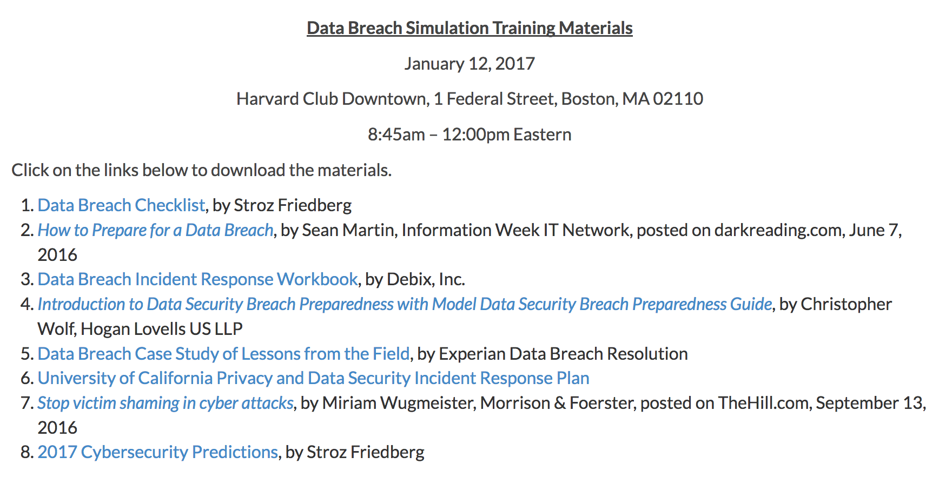
REFERENCE MATERIALS - AVAILABLE ON GTC SITE Harvard Club WIFI Password = veritas415
http://gtclawgroup.com/2017/01/data-breach-simulation-training-materials
PLUS A WORD VERSION OF THE “BETTER” INCIDENT RESPONSE PLAN –
PASSWORD IS “GTC2” – WE WILL REMOVE THE PASSWORD AFTER THE EVENT

Slide 4
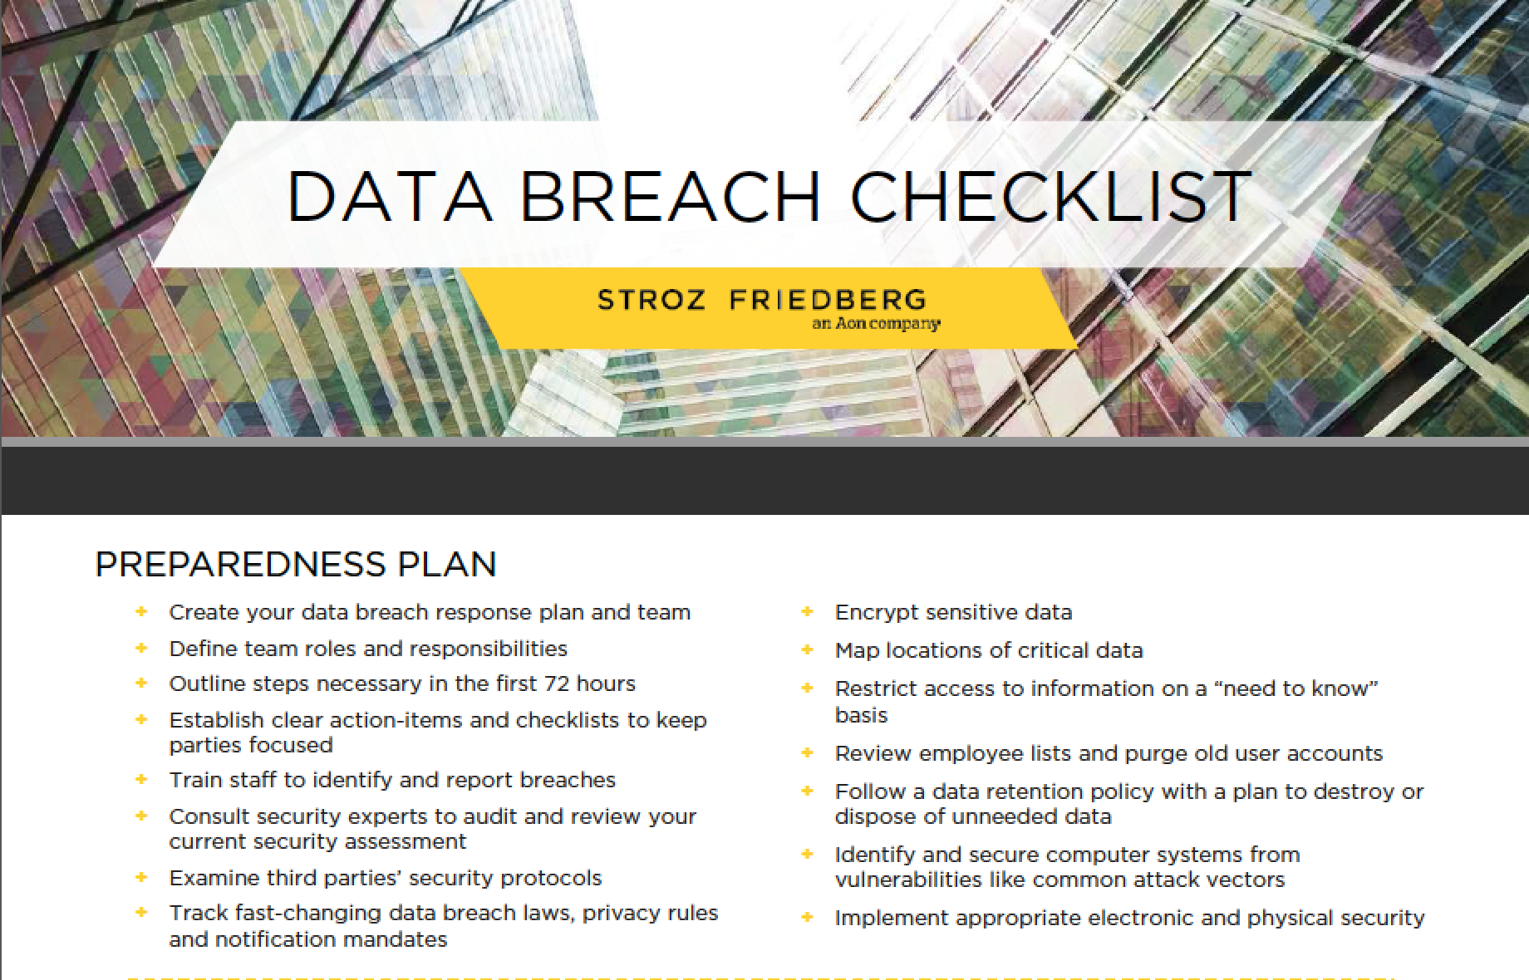

Slide 5
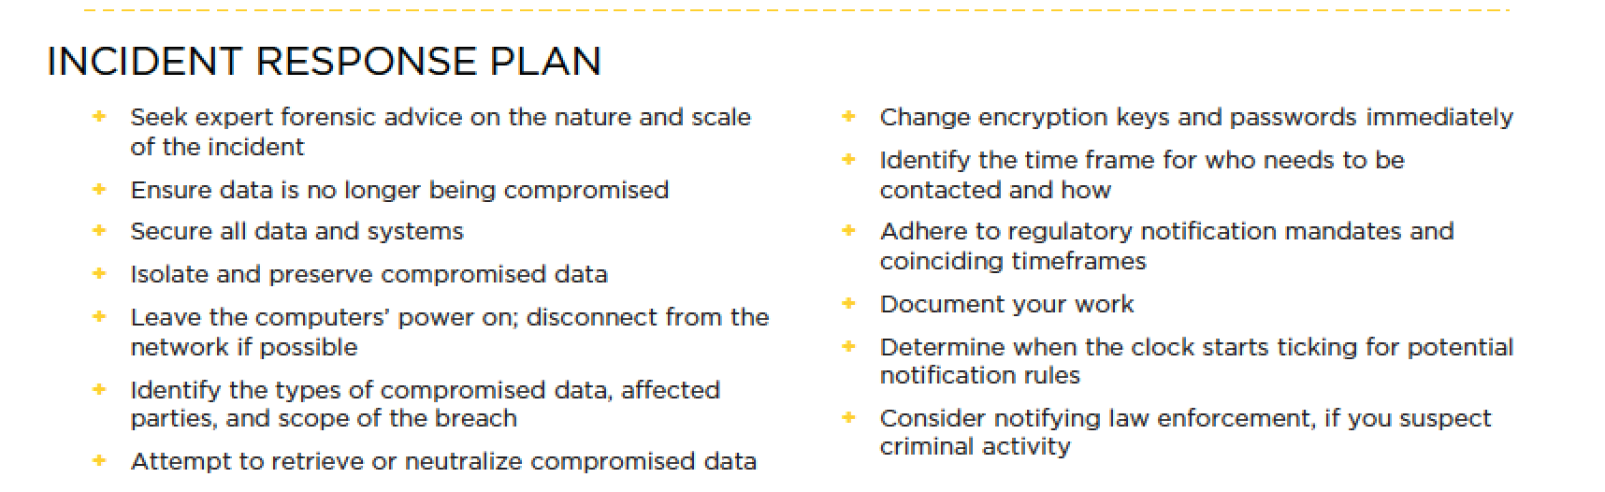

Slide 6
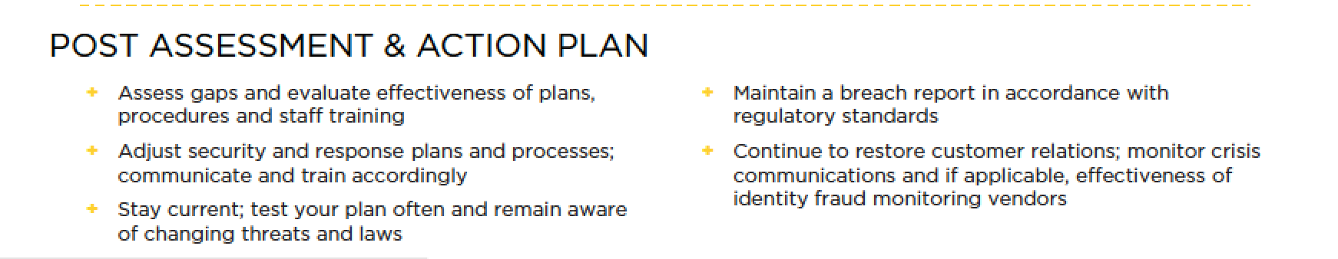

Slide 7
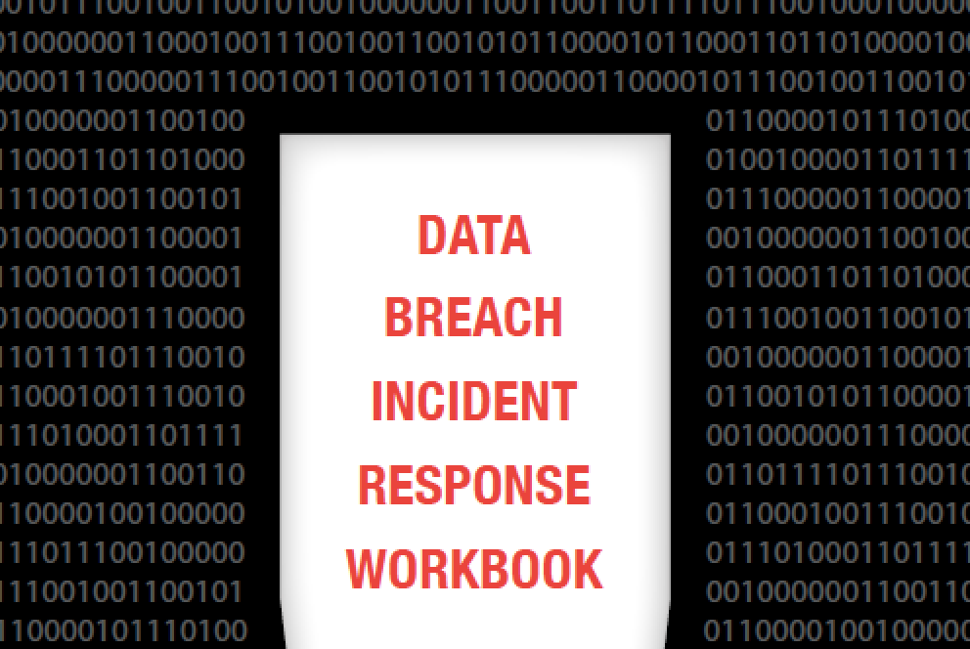

Slide 8
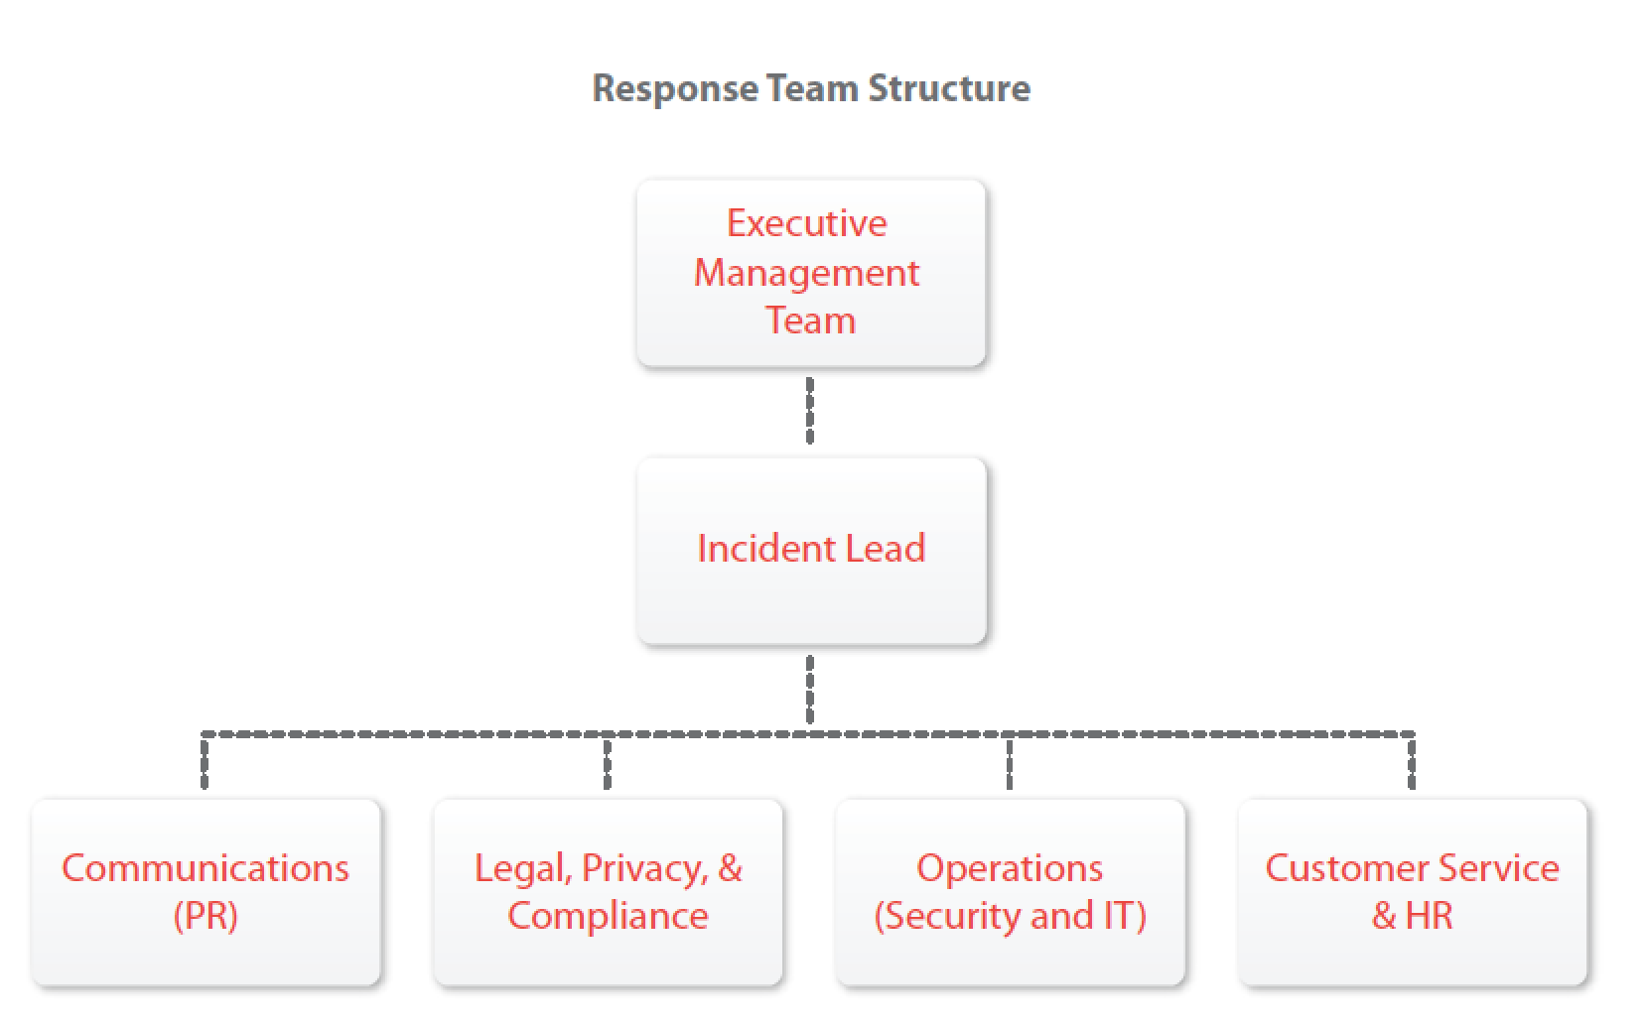

Slide 9
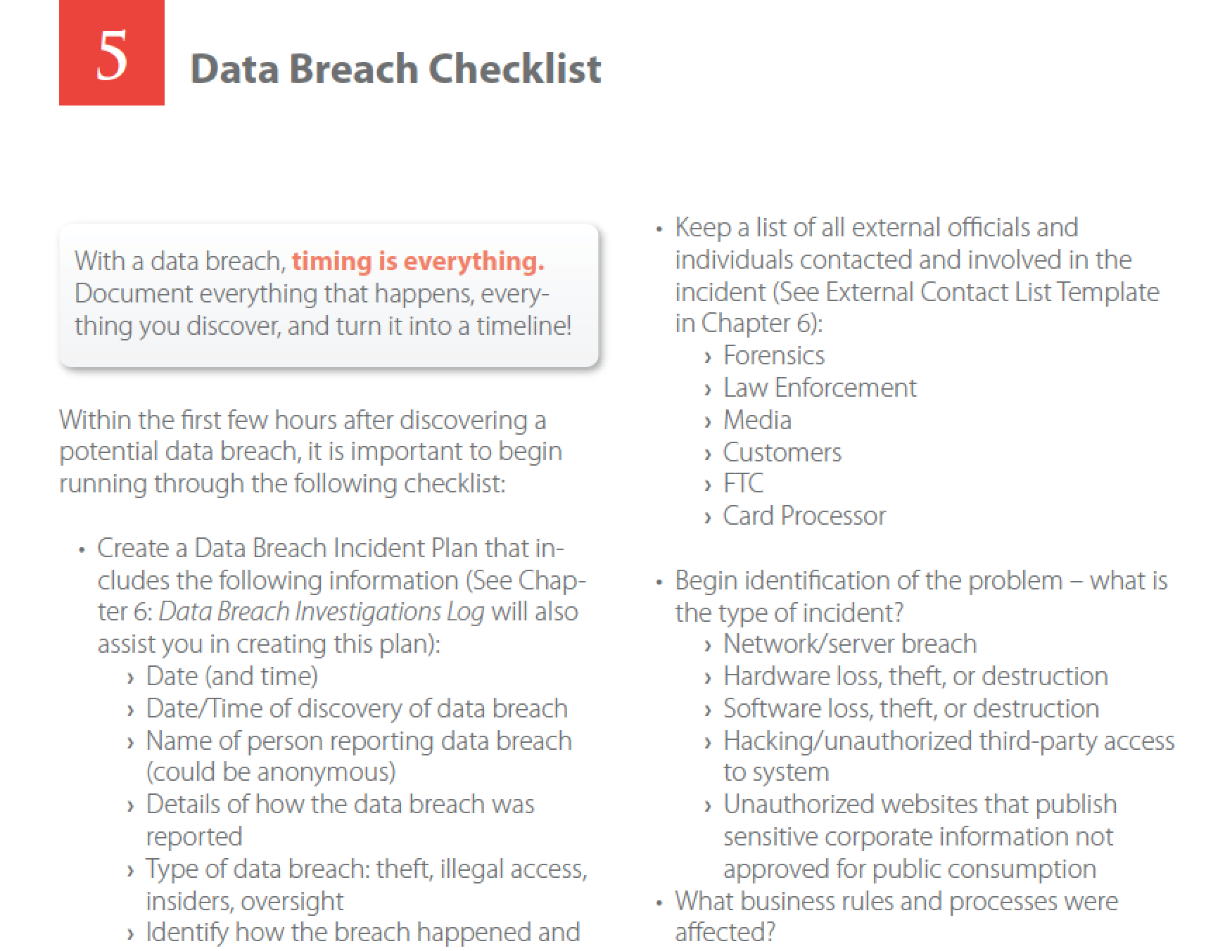

Slide 10
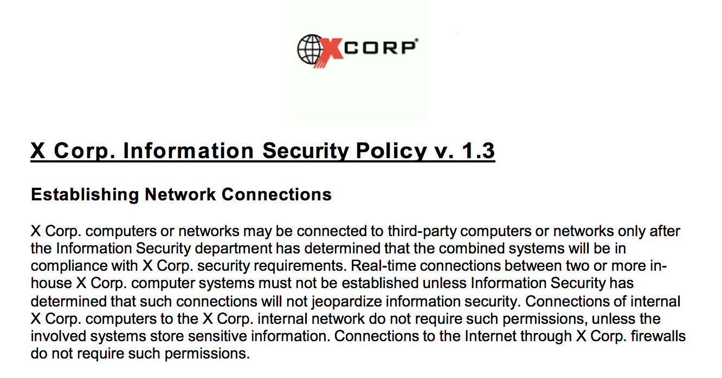
REVIEW KEY DEFECTS IN OUR EXISTING PLAN

Slide 11
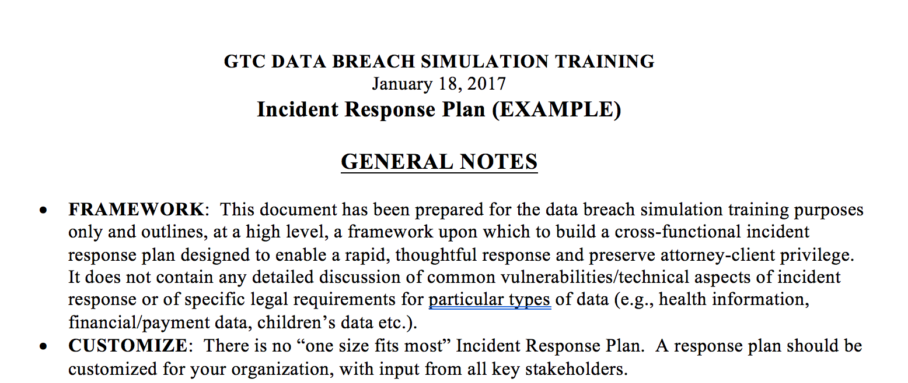
REVIEW “BETTER” INCIDENT RESPONSE PLAN
PASSWORD IS “GTC2”

Slide 12
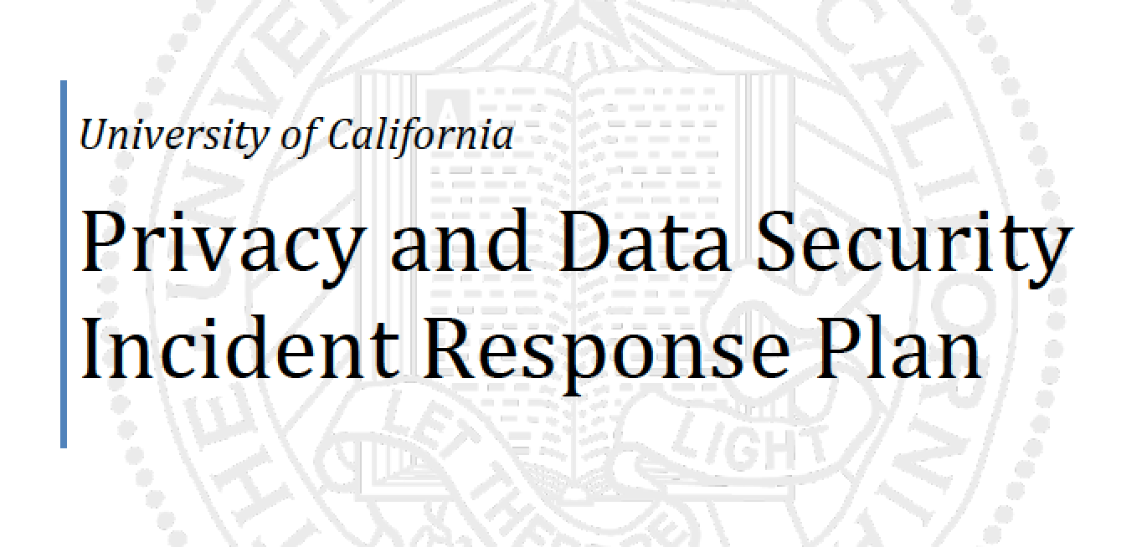

Slide 13
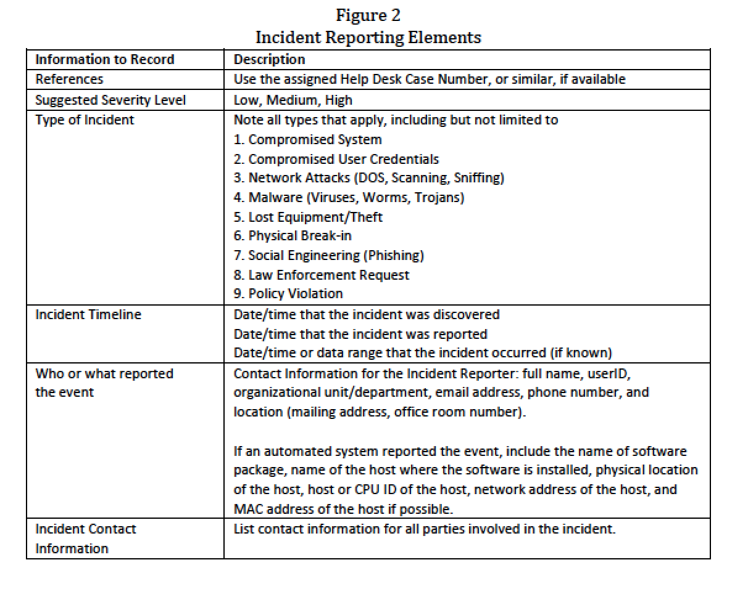

Slide 14
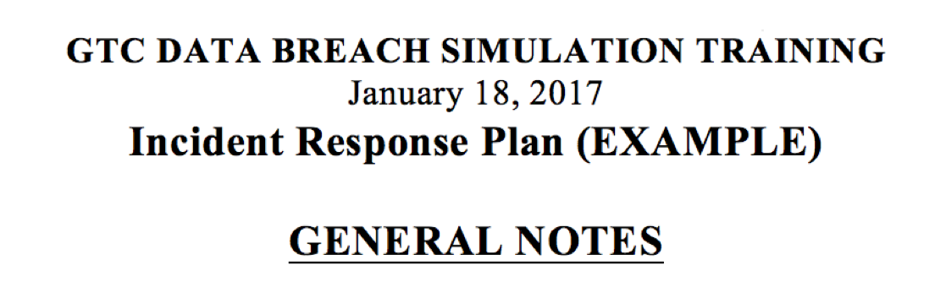
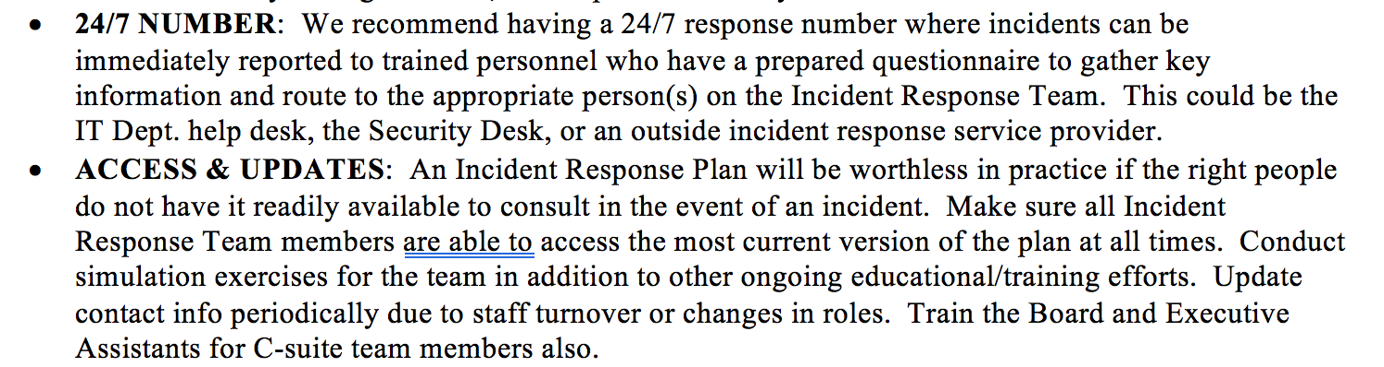

Slide 15
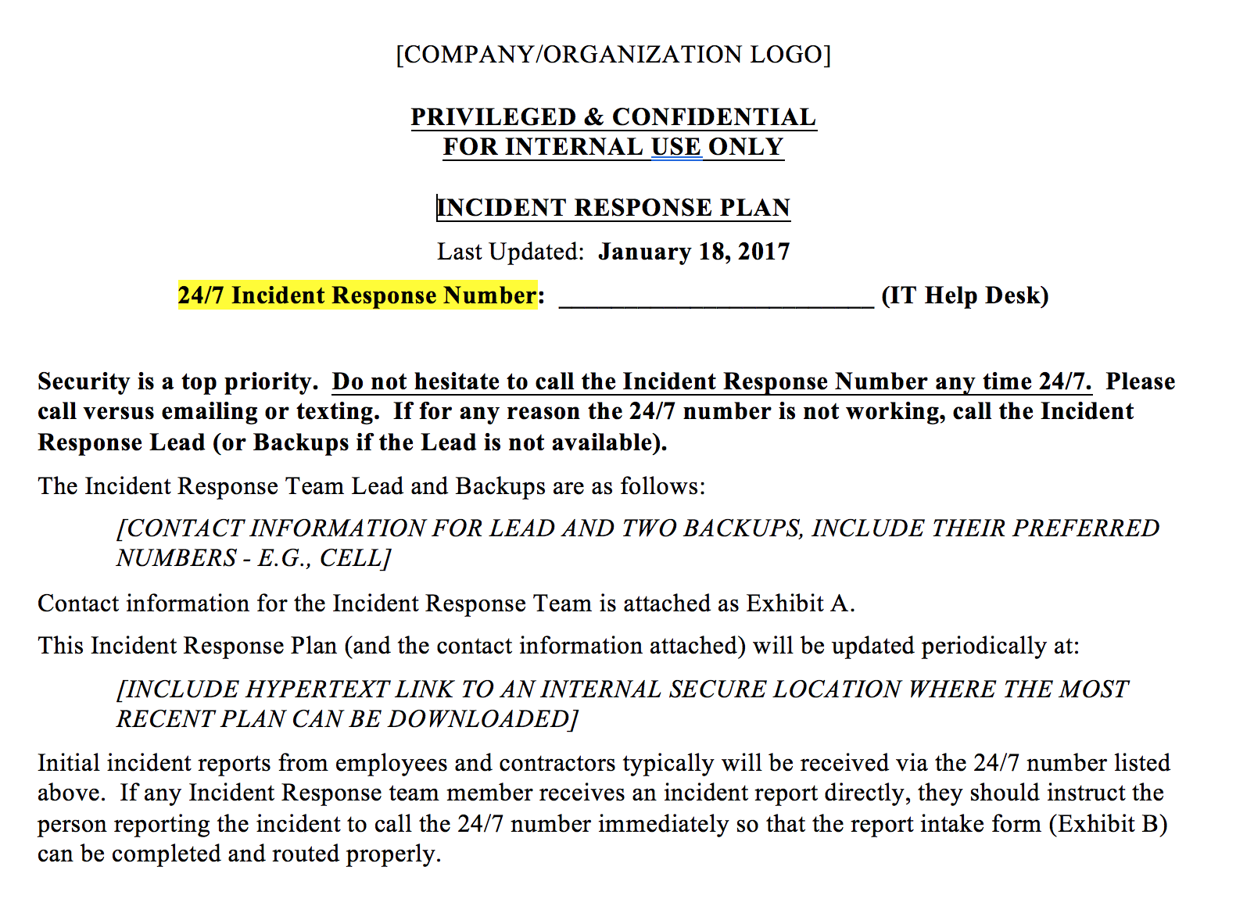

Slide 17
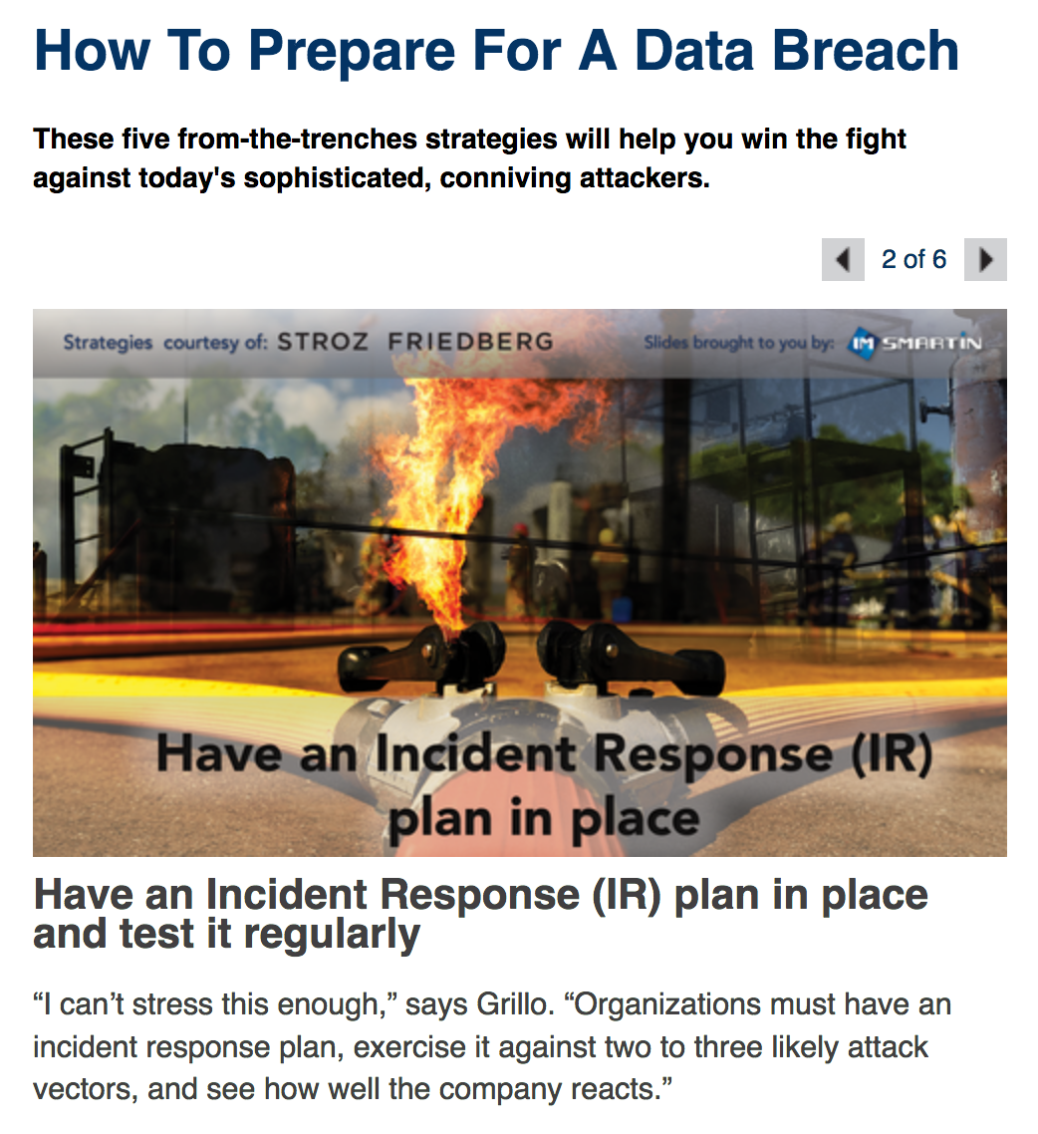

Slide 18
INCLUDE CONTRACTORS, NOT JUST EMPLOYEES
“A data breach at the US Navy has exposed the social security numbers and names of more than 130,000 current and former sailors, officials confirmed late on Wednesday—adding that "unknown individuals" had accessed the sensitive information.
Hewlett Packard Enterprise told the US Navy that one of its laptops operated by a contractor had been "compromised," however it didn't provide any further information about how the breach—affecting 134,386 sailors—had occurred…[The Navy] first learned of the incident on October 27 and said that a probe was now underway.”
— Arstechnica.com 11/26/16 (emphasis added)

Slide 19
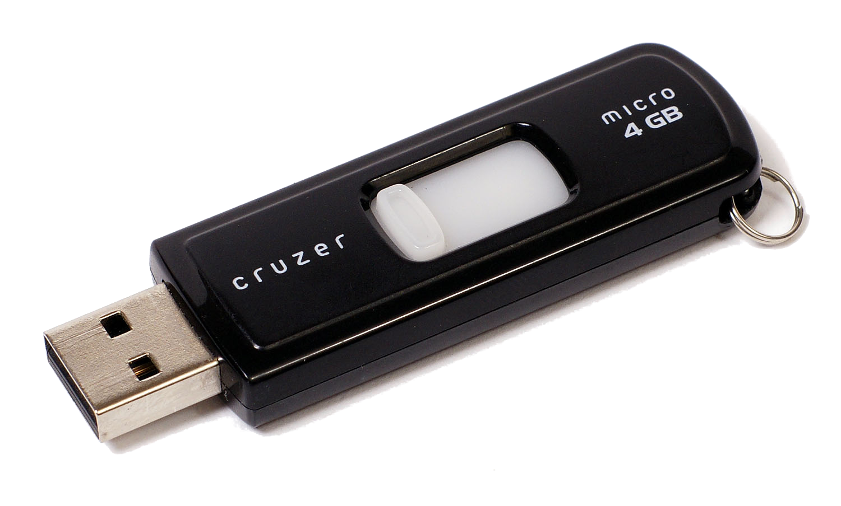
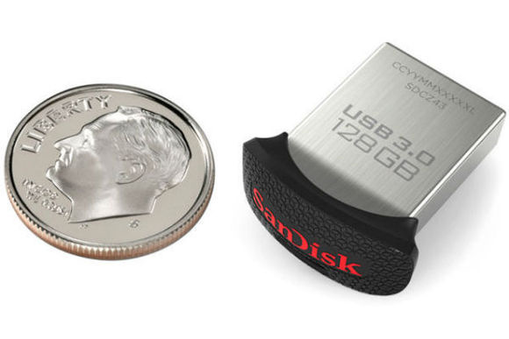

Slide 20
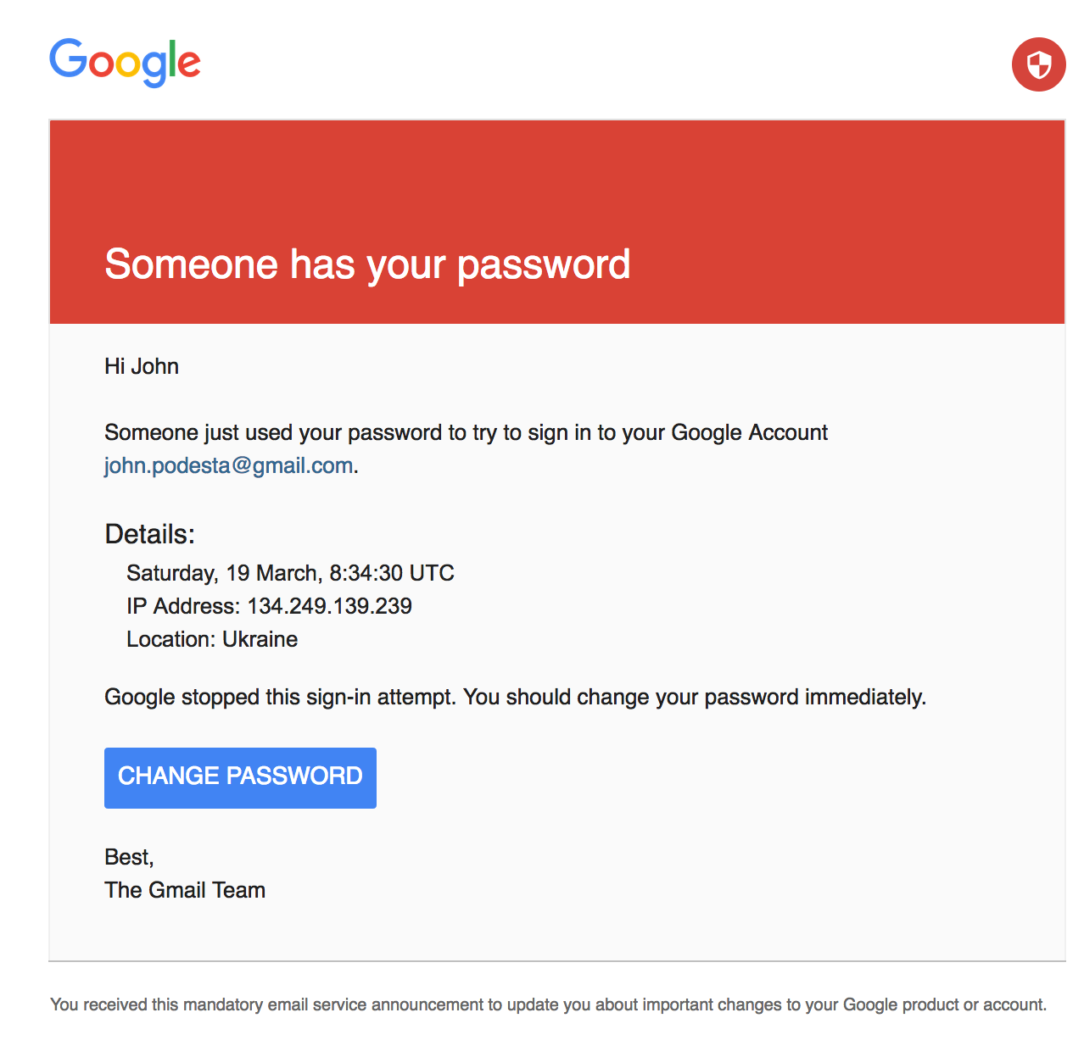
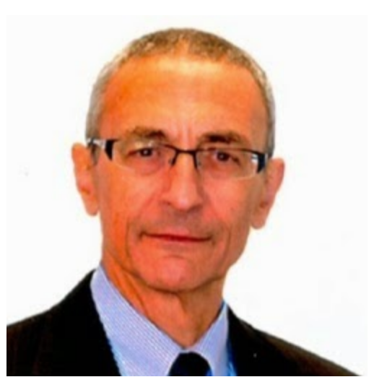
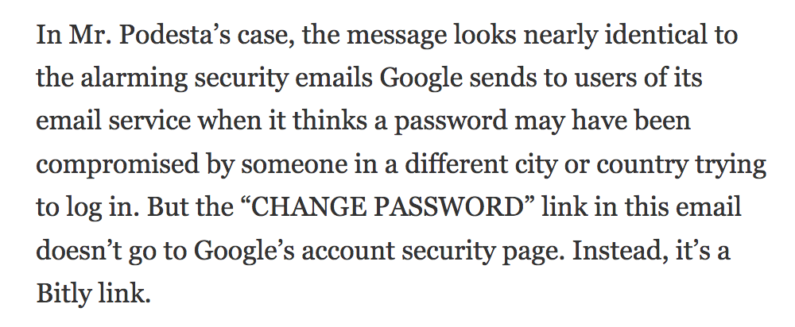


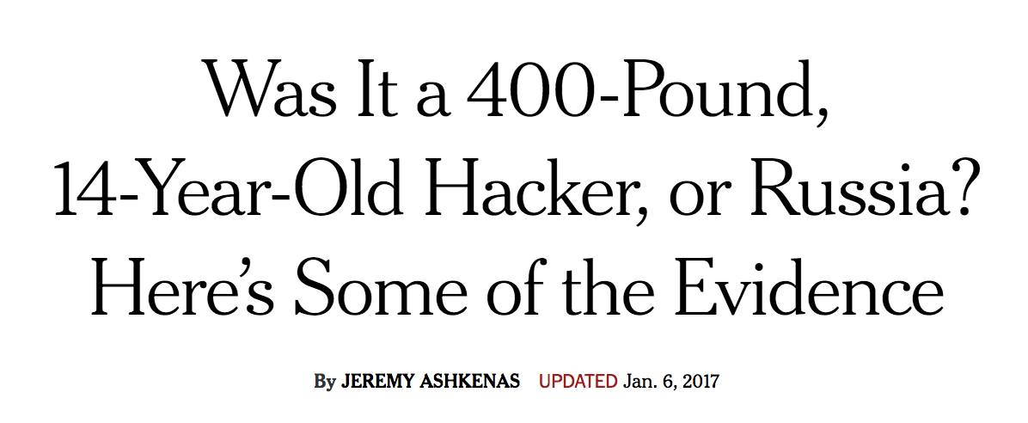

Slide 21

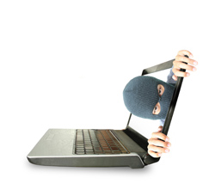
Don't click! Lawyers get fake emails about a complaint; hyperlink installs malicious software
By Debra Cassens Weiss
Posted Dec 05, 2016
Officials in multiple states are warning that emails inviting lawyers to click on a hyperlink to view a complaint will open a website that installs malicious software or on the lawyer’s computer, if the link is clicked.
Officials in New York, Texas, Pennsylvania, Maryland and Florida are among those warning about the scam. Lawyers who received such an email should delete it immediately and should not click on the link, according to a press release by New York Attorney General Eric Schneiderman.
Schneiderman’s press release and the Texas Bar Blog provide an example of one of the phishing emails. The “from” header lists “The Office of the State Attorney at com.department@outlook.com.” The subject lists “The Office of the State Attorney Complaint.”
“Dear bar member,” the email begins. “A complaint has been filed against your business. Enclosed is a copy of the complaint which requires your response. You have 10 days to file a rebuttal if you so desire. You may view the complaint at the link below.”

Slide 22
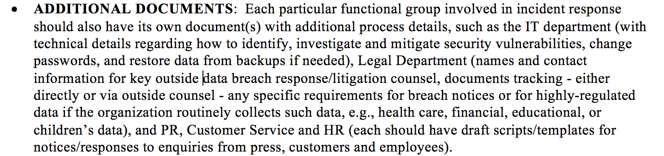

Slide 23
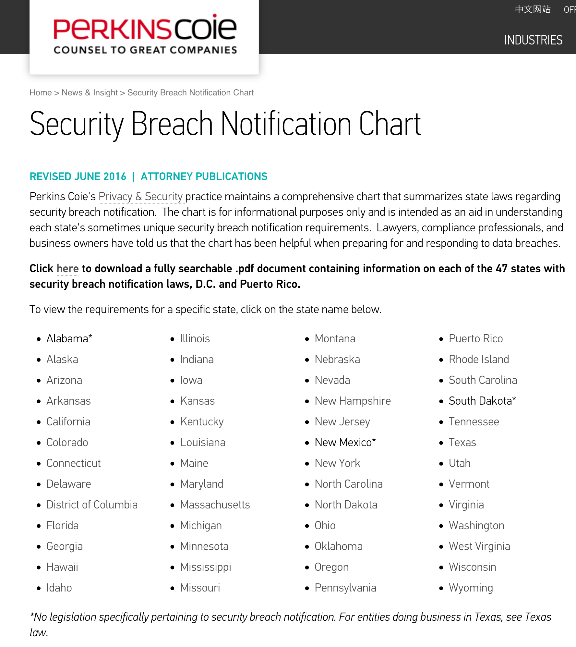
EXAMPLE – LEGAL DEPT. SHOULD HAVE A CURRENT, FREQUENTLY UPDATED REFERENCE TO DATA BREACH NOTIFICATION REQUIREMENTS

Slide 24
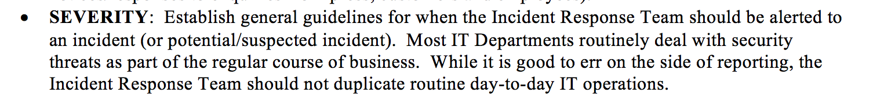

Slide 25
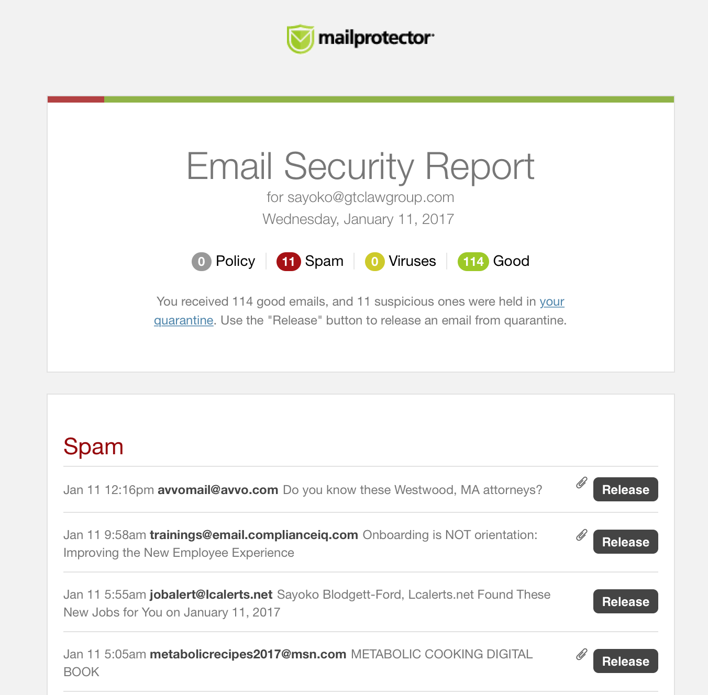

Slide 26

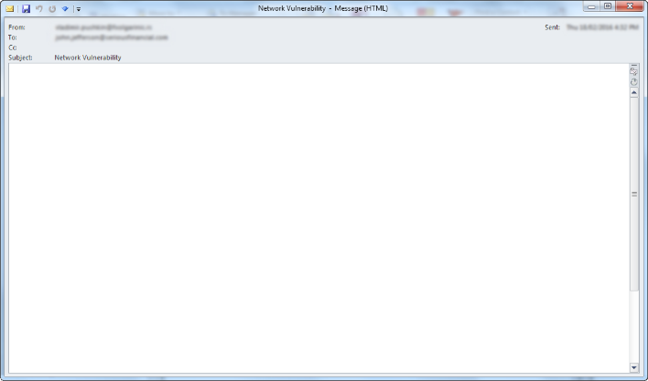


WHAT IS THE APPROPRIATE SEVERITY LEVEL?
Incident Simulation
DAY 1 – 5 a.m. Eastern
Saturday May 26, 2018
Mr. Smith,
We have found a vulnerability in your network that can put your employees at risk. We do not want to cause any harm but would like to get credit for our research. This is the kind of vulnerability that is not found by Penetration Testers, so you will be wasting your time if you try to find it out on your own. We can tell you all about it and recommend the fix if you transfer $500,000 via Bitcoin (see attached). We look forward for a smooth exchange. We are expecting a response within two days.
Thanks,
J. Vladimir

Slide 27
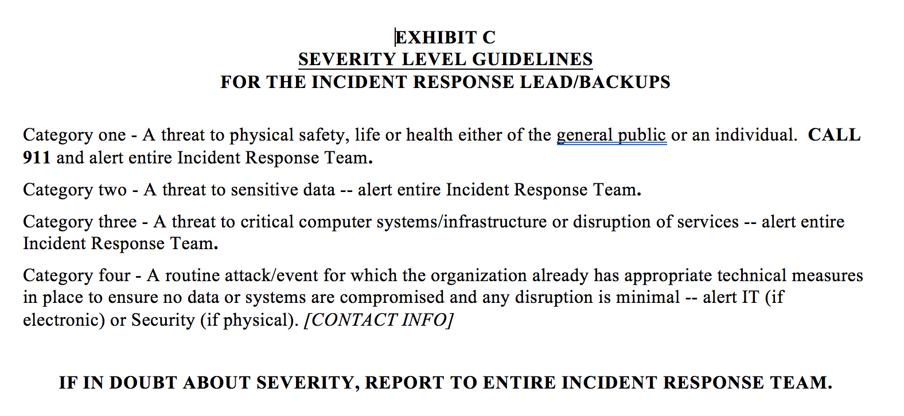

Slide 29
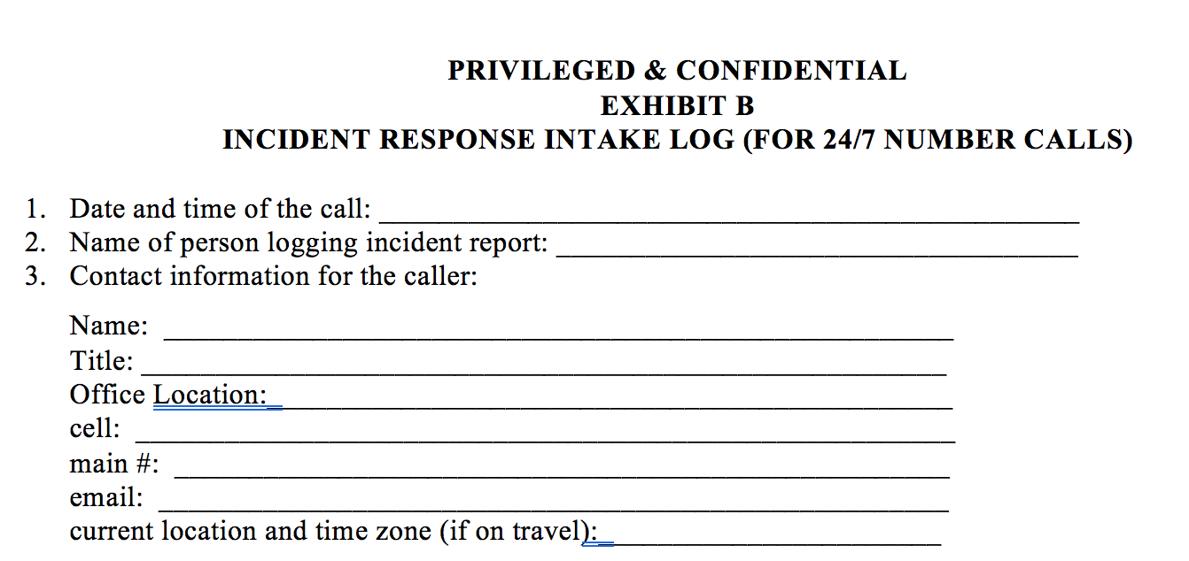
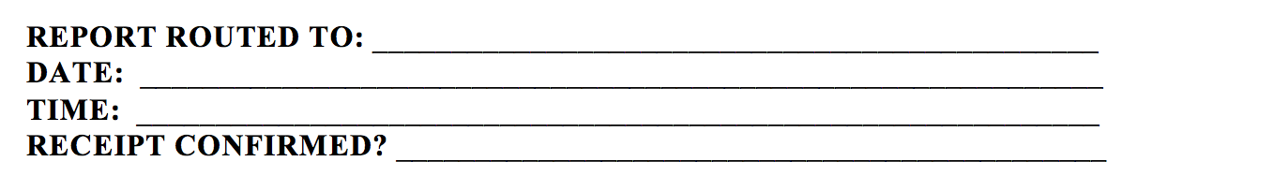

Slide 30
ACTION PLAN
SCAVENGER HUNT: See if you can find your organization’s Incident Response Plan easily, and randomly check with another key stakeholder in your organization to see if they can find it easily. Are there multiple versions?
CREATE/UPDATE: If you don’t have an Incident Response Plan (or if it has not been updated recently), create/update and schedule periodic checks/updates.
IT TAKES A VILLAGE: Form a cross-functional Incident Response Team if you do not already have one. Make sure there is a designated lead, the team meets regularly (e.g., quarterly) and receives regular updates on new threats/issues.
TRAIN: Plan an initial training (or an updated training). Consider various types of trainings – including periodic fake spearfishing exercises. Make sure that Management and Board members are appropriately trained.
STEP UP YOUR GAME: Seek outside expert advice as needed.

Slide 31
COMPLACENCY AND OVER-CONFIDENCE ARE YOUR ENEMIES
EVEN TRAINED “EXPERTS” ARE HUMAN AND CAN MAKE MISTAKES

Slide 32
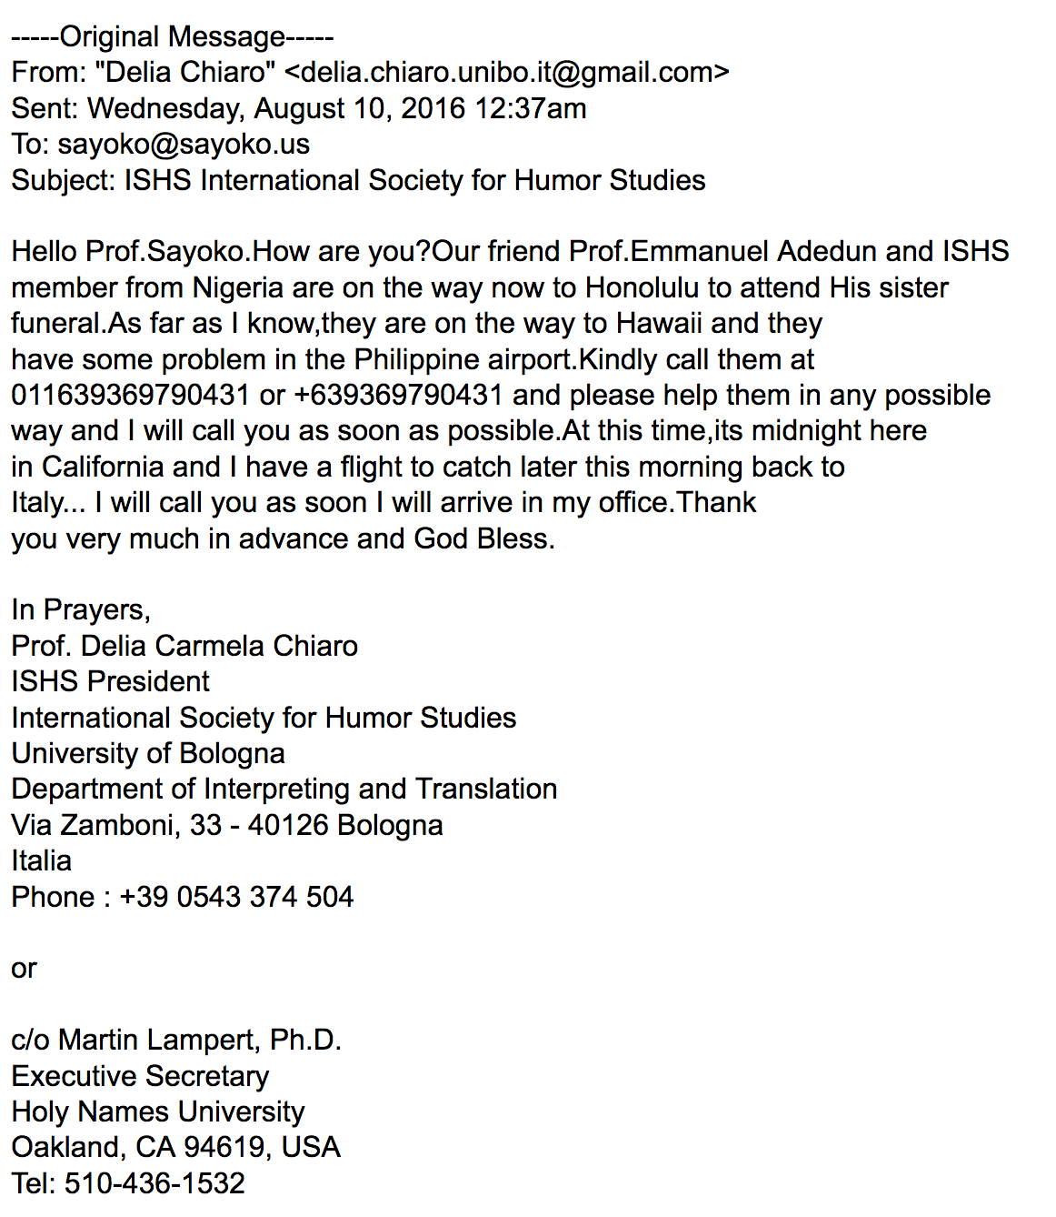

Slide 33
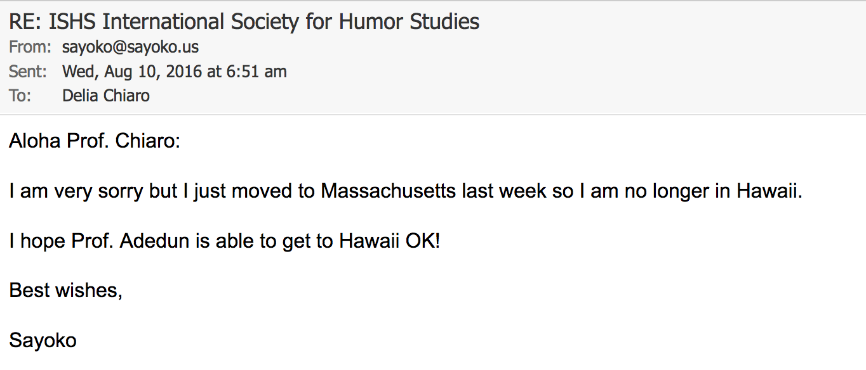

Slide 34
IT IS IMPOSSIBLE TO BE PERFECT AND TO FORSEE ALL POSSIBLE VULNERABILITIES, THREATS AND CHALLENGES
EVERYTHING IS CHANGING - ALWAYS

Slide 35

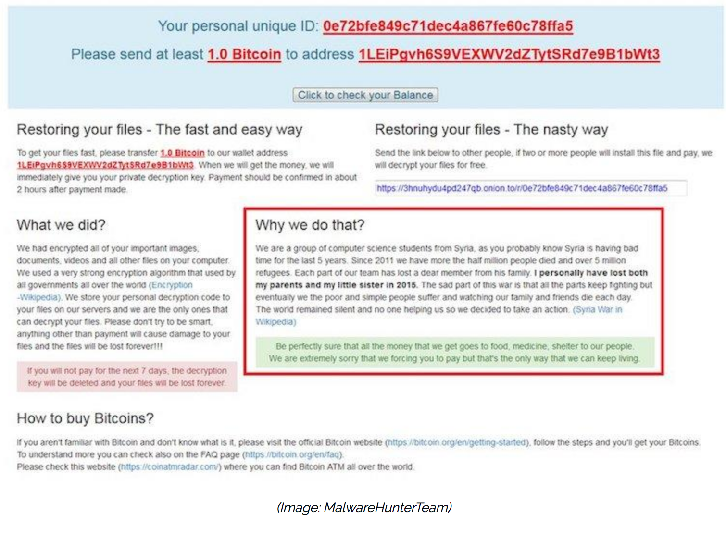

Slide 37
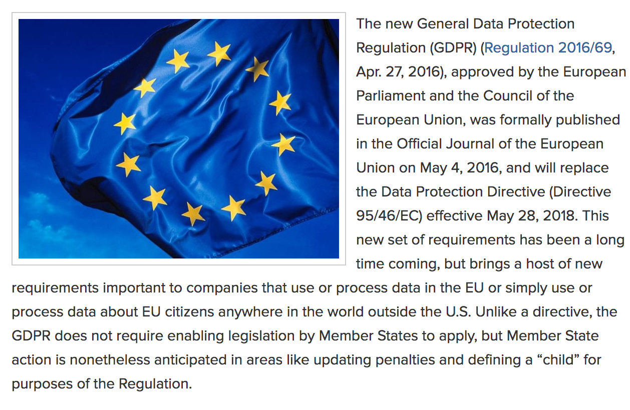

MAY 28, 2018

Slide 38


Slide 39
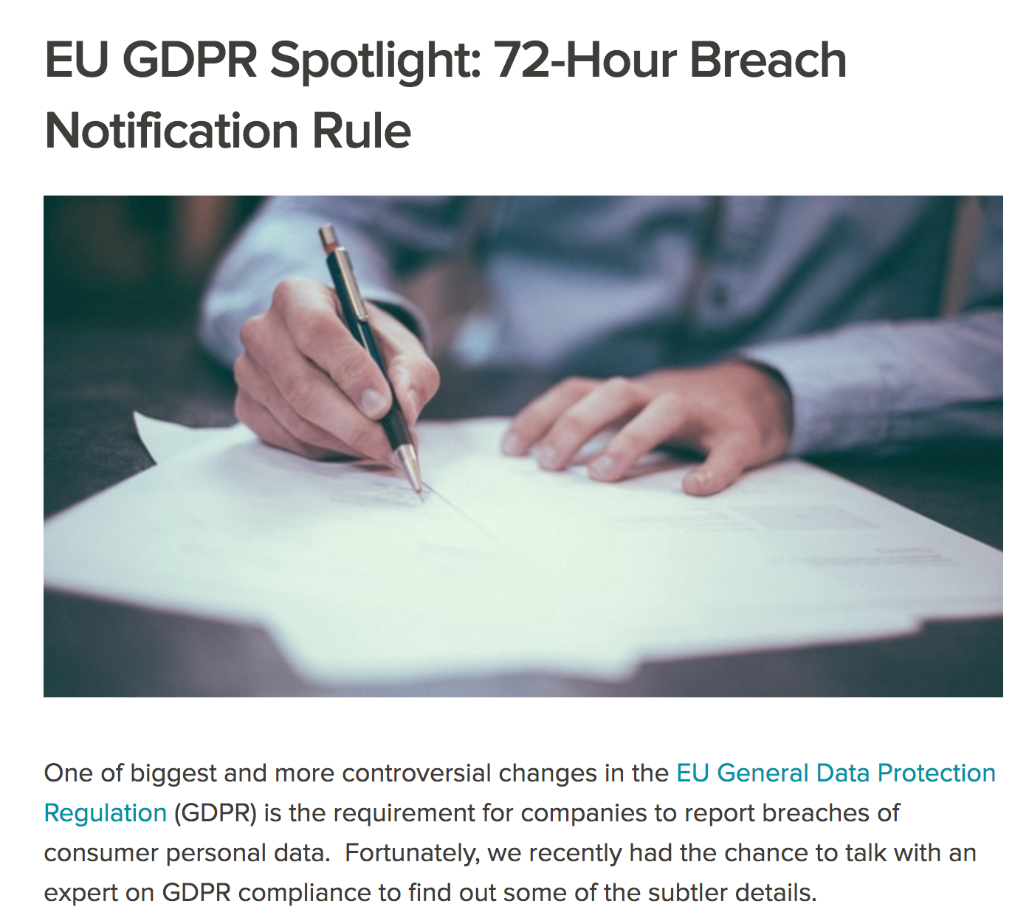
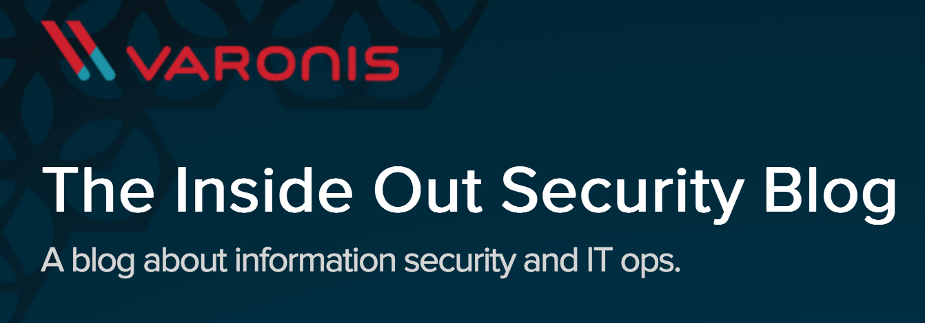

Slide 40
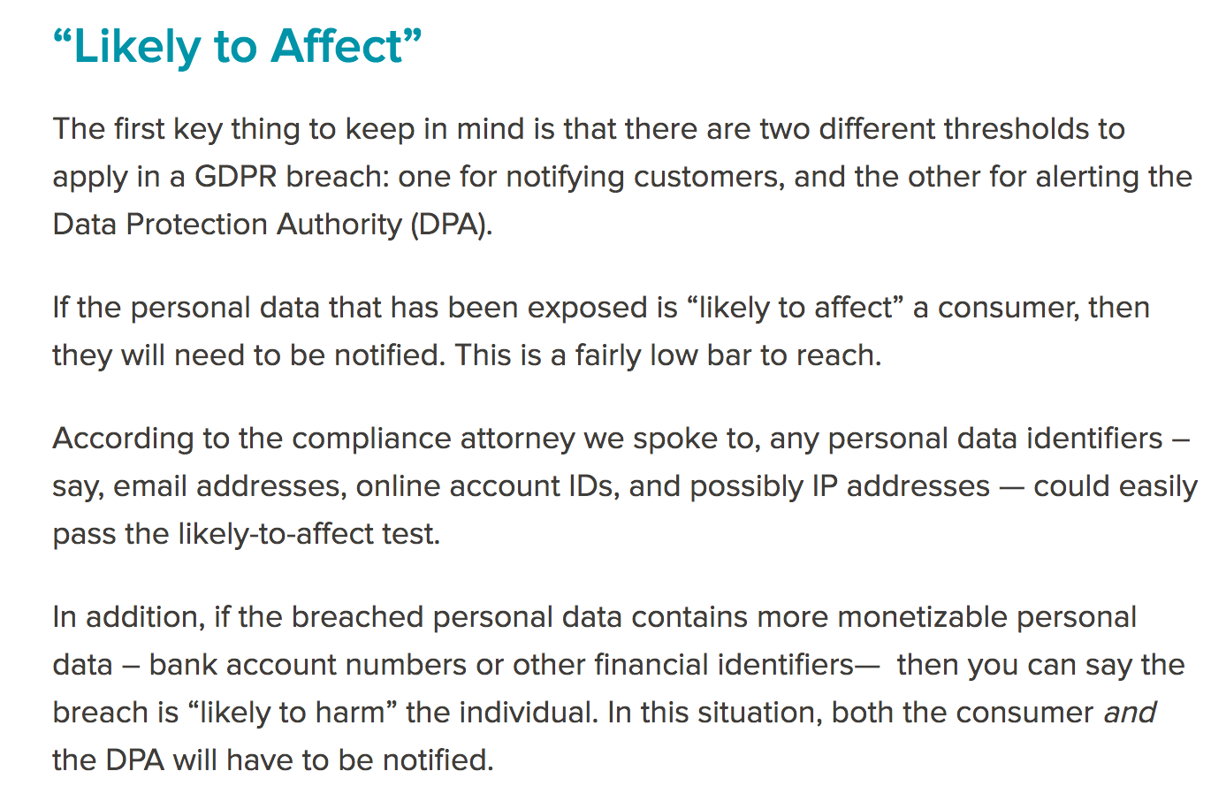

Slide 41


DON’T TRY TO BE PERFECT
JUST BE DAMN GOOD
AND KEEP DOING BETTER!

Slide 42
NEXT DATA/PRIVACY CONFERENCE – APRIL 6, 2017
European Data Privacy Compliance – Thursday April 6, 2017 8:45am - noon at the downtown Harvard Club (Boston).
David Bender, Special Counsel, Data Privacy GTC
Renard Francois, Global Chief Privacy Officer, General Electric
Katherine Fick, Privacy Counsel, IBM Corp.
Joseph Provost, Threat Modeling and Simulation Architect, IBM X-Force Command Center
Additional speakers to be confirmed.
We will provide practical guidance on the General Data Protection Regulation (“GDPR”) requirements, which will carry the most severe potential penalties we have ever seen in the data privacy area. Certain penalties could potentially be the greater of €20M or 4% of annual worldwide revenues. Although GDPR does not kick in until 2018, early compliance preparations are essential due to the scope and nature of the requirements.
EMAIL GTC@GTCLAWGROUP.COM TO SIGN UP OR CONTACT SAYOKO BLODGETT-FORD (sayoko@gtclawgroup.com)

Slide 43
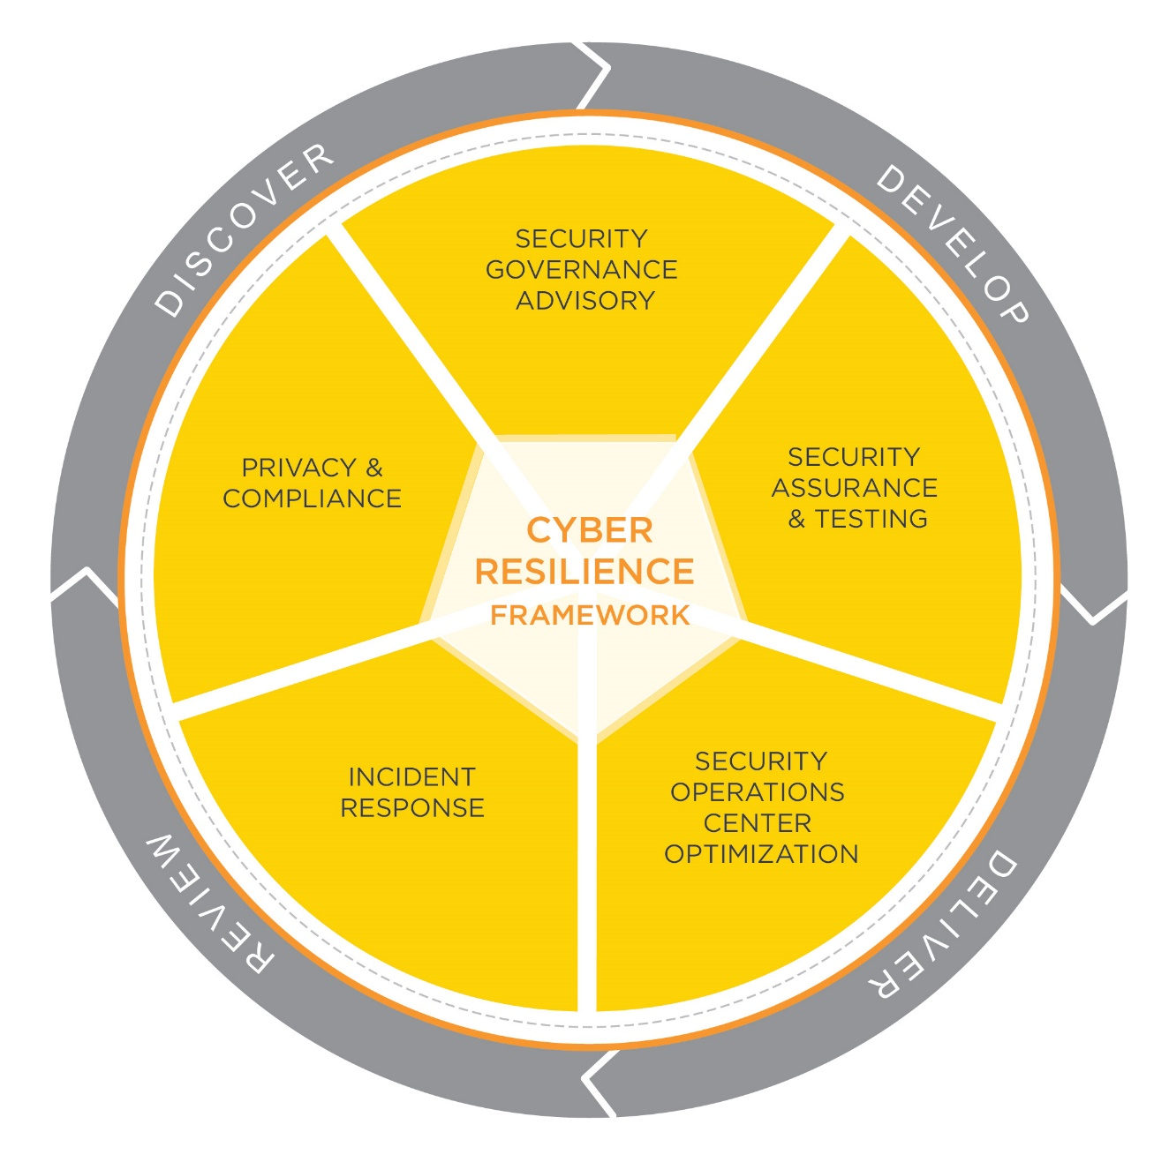
STROZ FRIEDBERG CYBER RESILIENCE OFFERING
THANK YOU TO STROZ -
CYBER RESILIENCE CONSULTING SERVICES
Assess key threats and vulnerabilities
Protect critical assets
Manage a breach effectively
Restore operations rapidly
Limit economic damage
Drive continuous improvement
Comply with regulatory requirements

Slide 44

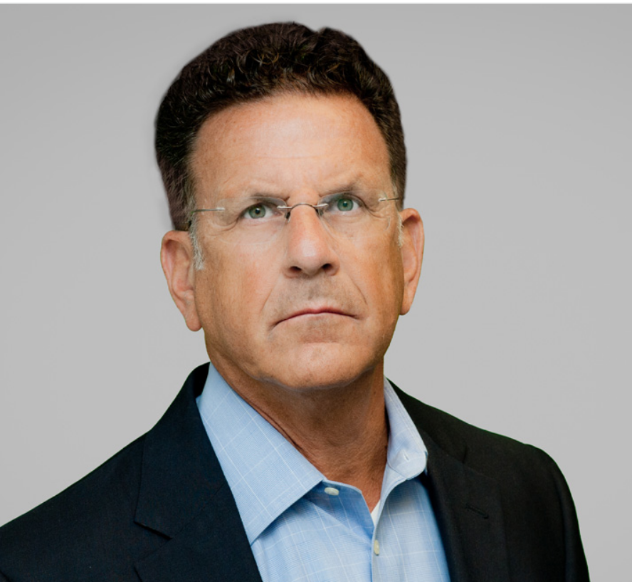
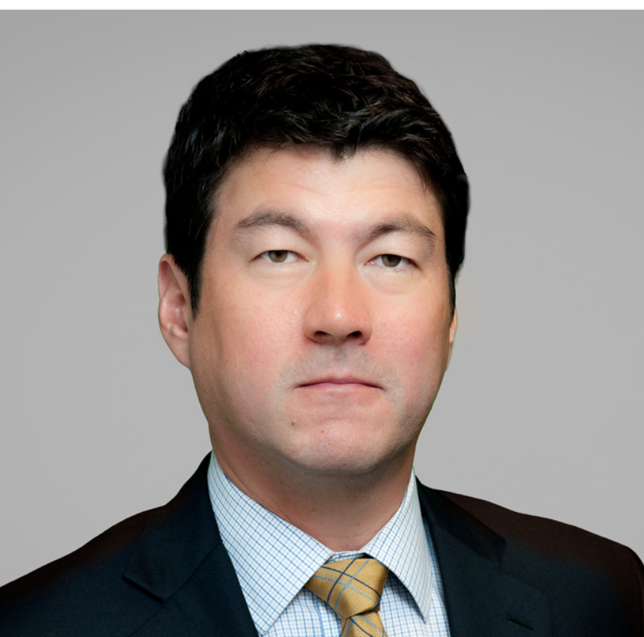
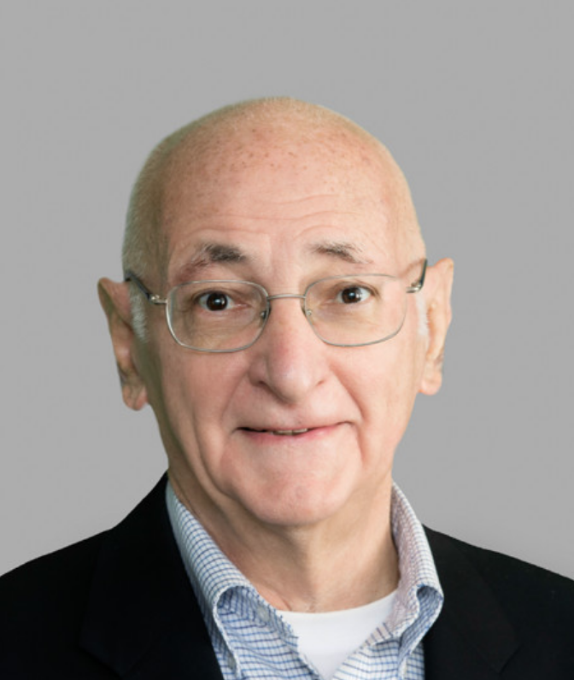
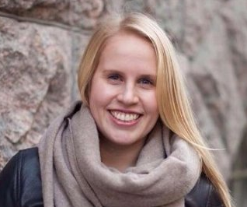
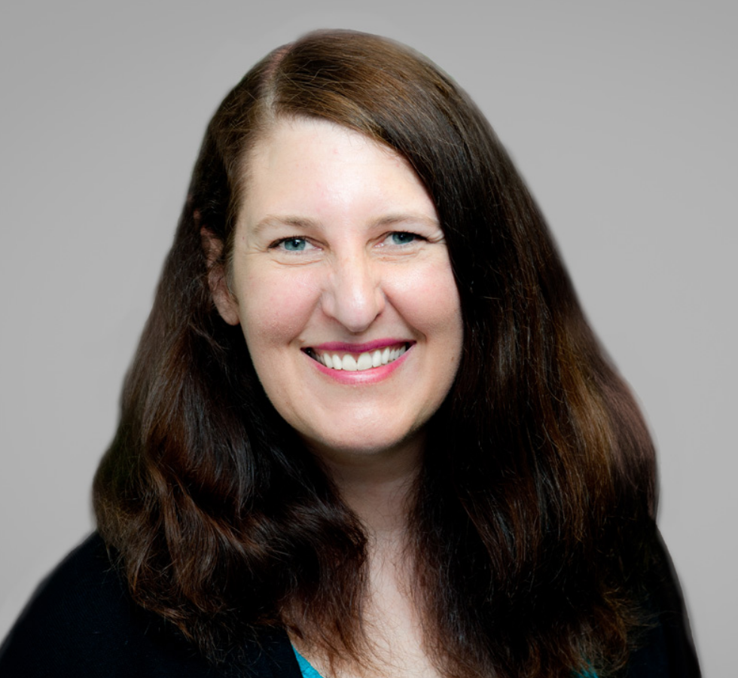
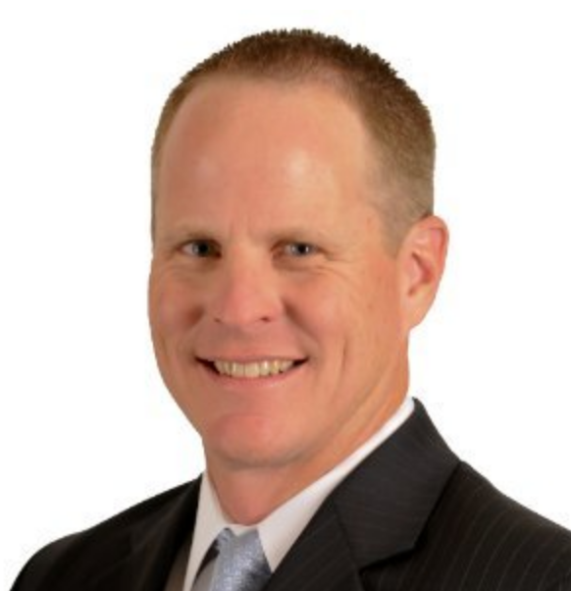
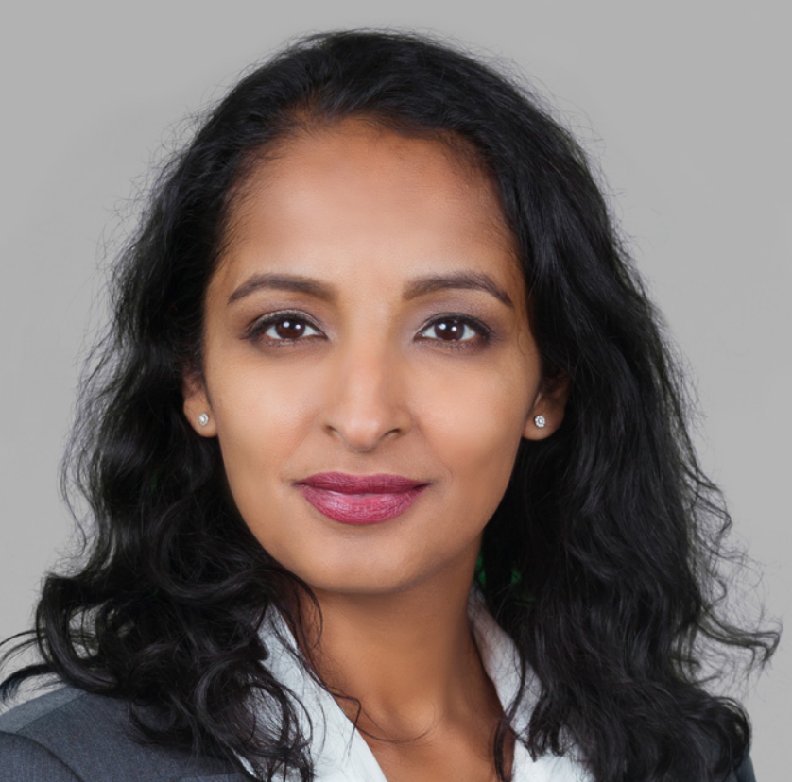
THANK YOU TO PANELISTS & TEAM LEADERS
Rocco Grillo, Executive Managing Director/Cyber Resilience Leader, Stroz Friedberg/Aon.
Peter Lefkowitz, Chief Privacy Officer and Senior Data Rights Management Counsel, GE Digital.
Patrick Ford, Chief Information Security Officer, Americas Region, Schneider Electric.
AND SURPRISE GUEST: Fred Mitchell III, Assistant to Special Agent in Charge,
U.S. Secret Service, Boston Field Office
TEAM 1
Tom Hemnes
TEAM 2
Rick Olin
TEAM 3
Paul Jean
TEAM 4
David Bender
Mirjam Supponen
TEAM 5
Jennifer Lavalley
Eric Ratcliffe (360Advanced)
TEAM 6
Laila Paszti

Slide 45
EVALUATIONS & CLE
Must sign out if you want CLE credit.
Evaluations are the GREEN cards (2 sided) –
Please also write in or email us suggestions for future events, including names of potential speakers (and if you would be willing to be a speaker), additional preferred venues outside of downtown Boston, and topics of special interest.

Slide 46
Thank You

Slide 47
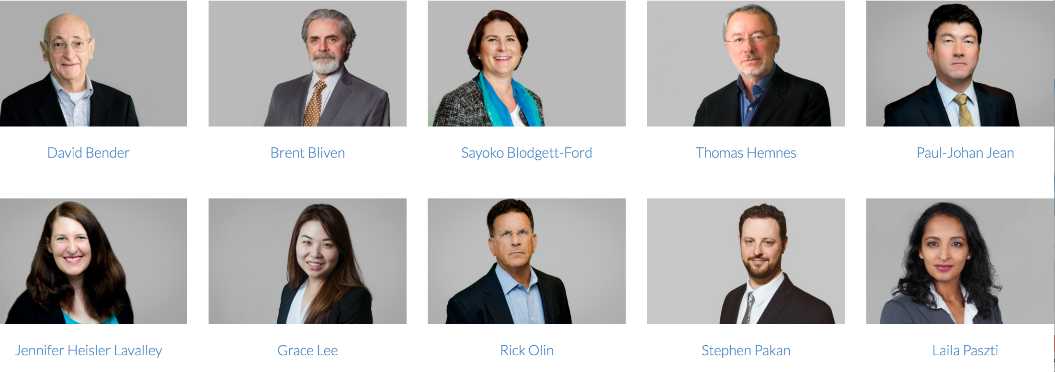
DATA PRIVACY & SECURITY
TEAM
Mirjam Supponen

